Slide 1
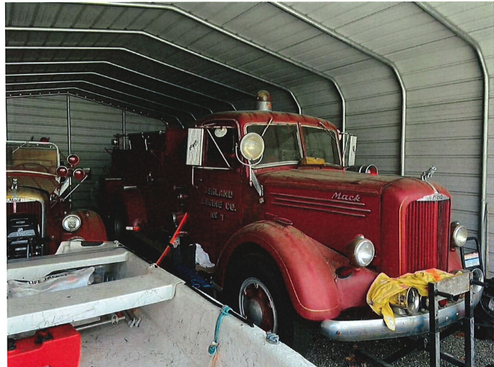
1947 Mack L Series Fire Truck

