Slide 1
Proposed articles for May 2023 Town Meeting
overall_0_132384652576050308 columns_1_132384652576050308
Ashland Sustainability – April 18 2023

Slide 2
Executive Summary
The Sustainability Committee has been working on a larger Multi Year Plan of Action
We consider these proposed resolutions as strategic steps contributing to our stated 2040 NetZero Goal
Our hope is to continue to collaborate with various stakeholders to either sponsor or co sponsor articles that moves us closer to achieving the NetZero Goal
Proposed Article
Rationale
Approval for the adoption of the Specialized Opt In code
The specialized code is designed to achieve Massachusetts GHG emission limits and sub-limits including a net-zero Massachusetts economy in 2050.
Net Zero Greenhouse Gas Emissions by the Town of Ashland, Inclusive of the Ashland Public Schools
The town set an example for residents by ensuring all future investments and contracts evaluate carbon neutral options and choose those options when supported by Total Life Cycle Analysis.

Slide 3
Accept Specialized Stretch Code
Article 13

Slide 4
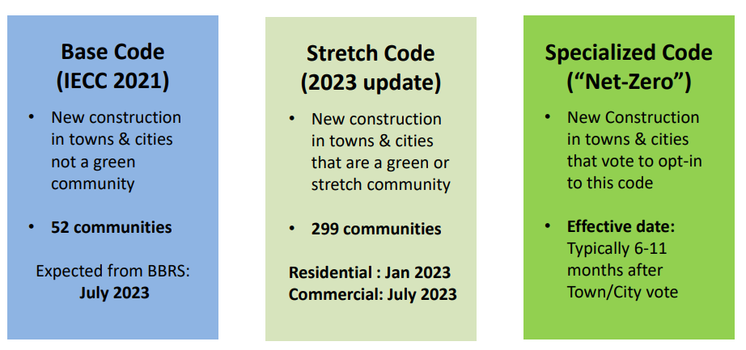
Massachusetts has 3 levels of building energy code
  Ashland has been a green community since 2012
  We propose adopting the Specialized Code
All apply to new construction and major renovations(>1000 sq. ft)
for both commercial and residential buildings.
Adapted from : https://www.mass.gov/doc/stretch-code-regulation-overview-presentation-nov-2-2022/download
Webinar available at : https://zoom.us/rec/share/AJ2ldaSMGcJOn7JlXDINoLTWbjMcz5A974v7Qi63qt-l88oXKdX6y9gxXjcDYpol.BQPSy5ObBOh0rGdg :

Slide 5
What is in the Specialized Code
1
Pre-Wiring
Buildings using fossil fuels must pre-wire for future electrification.
2
Solar Panels
Buildings using fossil fuels must install a certain amount of rooftop solar PV.
3
Exemplary Performance for Large Homes
- If using fossil fuels, single-family homes > 4,000 SF must be certified Zero Energy
- Multi-Family buildings >12,000 SF must use the Passive House pathway
4
Requirements for Electric Vehicle Charging
Commercial and Multi Family - 20 % of Parking must be wired for electric vehicles
Residential – at least one spot must be wired for electric vehicle
5
Potential Jump on Better Energy Ratings
HERS 42 (All-Electric) / HERS 45 (Mixed Fuel) required upon effective date of adoption (rather than July 1, 2024).

Slide 6
Why adopt the Specialized Code
Building energy is the largest contributor to GHG in Ashland followed by transportation
Critical first step for meeting GHG emissions goals and helps us stop digging the fossil fuel “hole”
New construction or major retrofits only
Makes long term economic sense
  Helps avoid costly future retrofits and delivers significant long term energy savings
  Sustainable building cost only 2-4% more and they are as much as 50 % cheaper to operate
Promotes
  Healthier, more comfortable indoor environments
Applies higher requirements sooner (stretch code updates in July 2024)
It is the right thing to do

Slide 7
Net Zero Greenhouse Gas Emissions by the Town of Ashland
Article 14

Slide 8
Net Zero for the Town of Ashland
1
Forward Looking
Pushes for a shift to Zero green house gas energy use only after it is viable
2
Life Cycle Cost Analysis
Requires financial evaluations to consider upfront cost, operating cost and viable life of the asset. Rather than just the cost of acquisition.
3
No Rip and Replace
Does not require replacement of existing systems during their effective life
4
Sensible exemptions
Decision makers are not painted into a corner
5
Allows time for implementation
12 months before effectiveness to support the transition
The town needs to set the example

Slide 9

overall_0_131600703282246985 columns_1_131600694444874709
Backup – Article 13

Slide 10
Specialized energy code requirements for commercial buildings
Both the Specialized and updated Stretch Codes use a new metric (HERS) regulating the amount of heating and cooling energy required.
Builders can use this metric or Passive House standards to comply. There are alternative standards for small commercial buildings (under 20,000 sq. ft.).
The Specialized Code encourages the use of all-electric heating, cooling, and hot water.
Buildings can use fossil fuel systems but must meet higher efficiency standards, be pre-wired for future electric systems, and have solar.
Both codes require 20% of parking spaces to be wired for electric vehicle charging

Slide 11
Specialized energy code requirements for residential buildings
The specialized code applies to all new construction or renovations > 1000 sq ft
The preference is to support the transition to Electric as the energy source
Buildings can still use fossil fuels, but will need to meet a higher efficiency standard
  The Specialized Code requires that buildings with fossil fuel systems must be pre-wired for future electric systems, and, for smaller buildings, must have solar.
The Specialized Code requires that new multifamily buildings over 12,000 sq. ft. meet Passive House standards or net-zero home performance scores.
Both levels of code require that any parking must be wired for at least one EV charger in small buildings, or 20% of spaces in multifamily buildings.

Slide 12
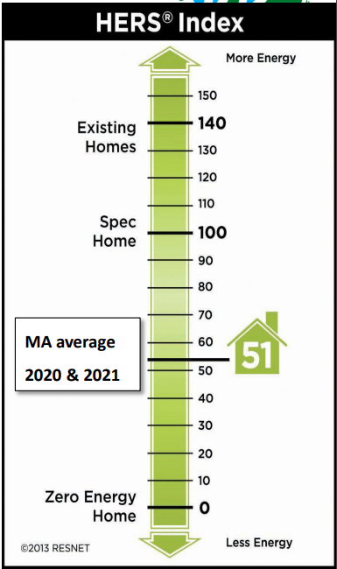
A Definition of HERS Rating (the MPG for your home)
The new Stretch code and Specialized code both use the HERS (Home energy rating system) to establish requirements
HERS is an industry standard index used to measure the energy performance of a Home.
HERS is about how efficiently your home uses energy as compared to a Spec home (100) built in 2006.
The specialized code would require new homes to be 55% more effective than the reference.
  All new homes in Ashland are already required to be 45% more efficient.

Slide 13
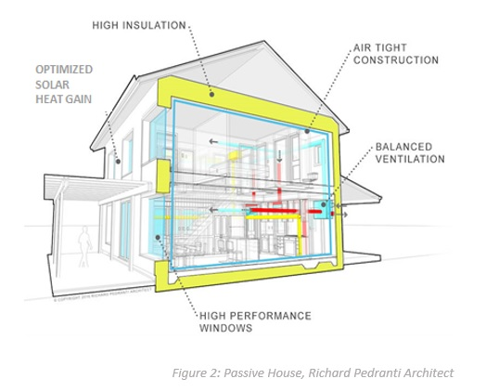
Passive House
Passive House is a set of performance-based building certification standards that focus on the significant reduction of energy demand while ensuring a healthy and comfortable building.
Features of Passive House
Building Envelope:
  Exterior Thermal Insulation
  Continuous Air-Barrier
  Thermal Bridge Mitigation
  High-Performance Windows & Doors
Optimized Solar Heat Gain Mechanical Systems:
  Balanced Ventilation with Heat Recovery
  Efficient and Minimized Heating/Cooling
  High-Efficiency Water Heaters
https://www.phius.org/phius-related-incentives-massachusetts

Slide 14
The Adoption Process
The Specialized Code can be adopted by Green Communities with a warrant article at Town Meeting
We recommend the new stretch code be effective September 1 2023
  This will provide sufficient time for training builders and other stakeholders and to make any adjustments
7 Towns and Cities have already adopted the code (an additional 23 are in process)
  Watertown 1.10.23 (July 2023 adoption)
  Brookline 1.10.23 (July 2023 adoption)
  Cambridge 1.23.23 (July 2023 adoption)
  Newton 1.27.23 (July 2023 adoption)
  Lincoln 3.18.23 (January 2024 adoption)
  Lexington 3.26.23 (January 2024 adoption)
  Boston 4.5.23 (January 2024 adoption)
We hope we can count on your support

Slide 15
Increased incentives for Builder and Developers
All-electric homes are generally cheaper to build
  Heat Pump replaces both Central A/C + Furnace
Mass Save 1-4unit all-electric incentives
  $15,000 for HERS 45 (very efficient homes, that will become the standard)
  $25,000 for HERS 35 / Passive House (extremely efficient homes that beat the standard)
Federal IRA:
  45L tax credit: $2,500 or $5,000/home (aligned with HERS)
  179D tax credit: up to $6/sqft for commercial & multi-family
  https://www.masssave.com/saving/residential-rebates/all-electric-home
  https://www.masssave.com/saving/residential-rebates/passive-house-incentives
  https://www.phius.org/phius-related-incentives-massachusetts

Slide 16

What happens to the grid when we electrify everything
The state of Massachusetts completed a study in 2021 when developing the revised code that found
The same or lower peak electric use for most building types
Modest peak electric increases in residential
Across Massachusetts: about 5% increase in peak electric
Key is demand reduction, which is the priority in the new code with the focus on increased energy efficiency requirements

Slide 17
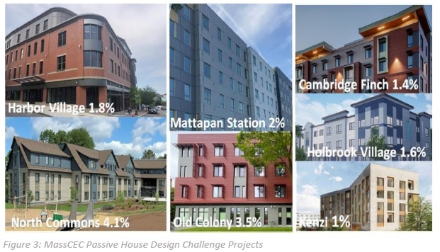
Are efficient buildings really that expensive
Average Incremental building costs: 2-4% *
Typical Cost Increases
  Window shading features to prevent summer overheating
  Ventilation upgrades to supply fresh air to living and bedrooms
  Air sealing
  Window upgrades
  Design and consultant costs (offset by available grants)
Typical Cost Savings
  Significantly reduced Heating and Cooling costs (both equipment and running)
  Operating costs are as much as 50% lower compared to typical homes
Scaling Up Passive House Multifamily: The Massachusetts Story
* Based on MassCEC’s Passive House Design Challenge issued in 2018

Slide 18
What is additional in the specialized code
Low rise Residential
Multi Family Passive House
Commercial (except multi family)
Builds on stretch code with 3 paths
  All Electric
    HERS 45 or
    Passive House
  Mixed Fuel
    HERS 42 +Solar install + Wired for electric or
    Passive House + Wired for Electric
  Zero Energy:
    HERS 0 (HERS 42 + Solar) or
    Passive House (Phius Zero)
New homes 4000 sq+ must use All Electric or Zero Energy
Additions and Alterations would follow the stretch code
January 2023:
  Passive House required for 5 stories or less, if over 12,000 sf
  6+ Stories choose TEDI or HERS 42/45 or ASHRAE App. G
January 2024:
  Passive House required for all Residential over 12,000 sf
All Electric
  All Stretch code efficiency requirements
  Passive House
    Passive House and Stretch code requirements +
    Electric Ready (Pre- Wiring)
  Gas or Other Fossil Fuel
    All Stretch code efficiency requirements
    Electric Ready (Pre- Wiring)
    Solar Onsite where feasible
Solar PV
  Required (when using Fossil Fuels or Zero Energy
  Optional for All Electric
  Exceptions for shaded sites can reduce minimum size

Slide 19
Multi Family Homes
Building Type | Fuel Type | Stretch code (July 2024) | Specialized Code
New Multi-family (4+ stories & over 12,000 sf) | All Electric | HERS 45 or TEDI or Passivehouse | Passivehouse
 | Mixed Fuel | HERS 42 or TEDI or Passivehouse | Passivehouse + wiring for electrification

Slide 20
overall_0_131600703282246985 columns_1_131600694444874709
Backup – Article 14

Slide 21
Vehicles and Equipment
The Town of Ashland will consider buying or leasing vehicles and equipment that have zero greenhouse gas emissions by comparing total lifecycle costs where a zero greenhouse gas emission option is available.
Though this section does not require the purchase of zero greenhouse gas emission vehicles and equipment at this time, the transition to zero greenhouse gas emission vehicles and equipment must begin in order to meet the commitment to Net Zero in 2040.
Given there is often no suitable Zero Greenhouse Gas vehicles suitable this section is forward looking for when these options become available and viable.

Slide 22
Buildings
The Town of Ashland shall only implement zero greenhouse gas emission technologies in new buildings and improvements or retrofits of existing buildings.
Examples of building functions using greenhouse gas emitting technologies include space and water heating, cooking, and backup power.
Heat pumps and battery storage are examples of zero greenhouse gas emission technologies that can be used in these building functions.
Natural gas plumbing must not be added to new buildings or as part of a retrofit to a building.
There are already viable technology options for buildings. Buildings have long life spans so any new investments need to move towards Net Zero options

Slide 23
Electricity Supply
The Town of Ashland shall only purchase electricity that is from 100% renewable sources.
Contracts to purchase electricity that do not meet the 100% renewable requirement, existing at the time of adoption, will continue, but will not be extended.
Given the move to electrification it is critical that the supply of electricity be from renewable sources

Slide 24
Exemptions
Buildings may have equipment repaired and replaced that is functionally equivalent to existing equipment.
Improvements and retrofits to existing building equipment are not exempt from the requirement to implement zero greenhouse gas emission technologies.
Buildings may use greenhouse gas emitting technologies for safety purposes if specifically approved by the appropriate entity responsible for their respective building.
Focus is on new investments and the Town retains the ability to approve exemptions if absolutely required

