Slide 1
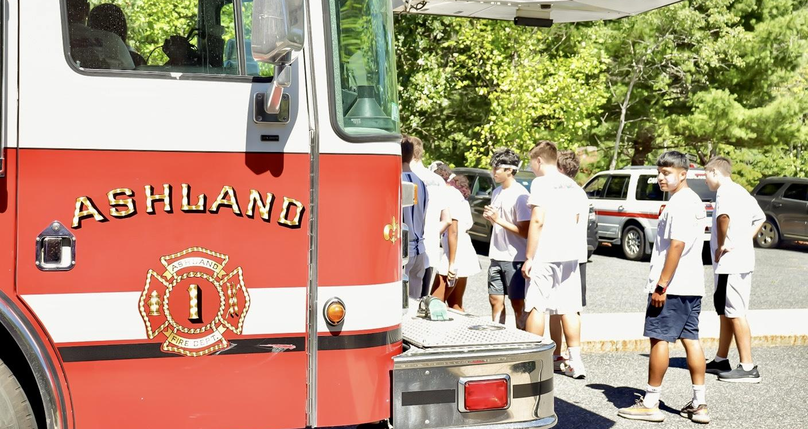
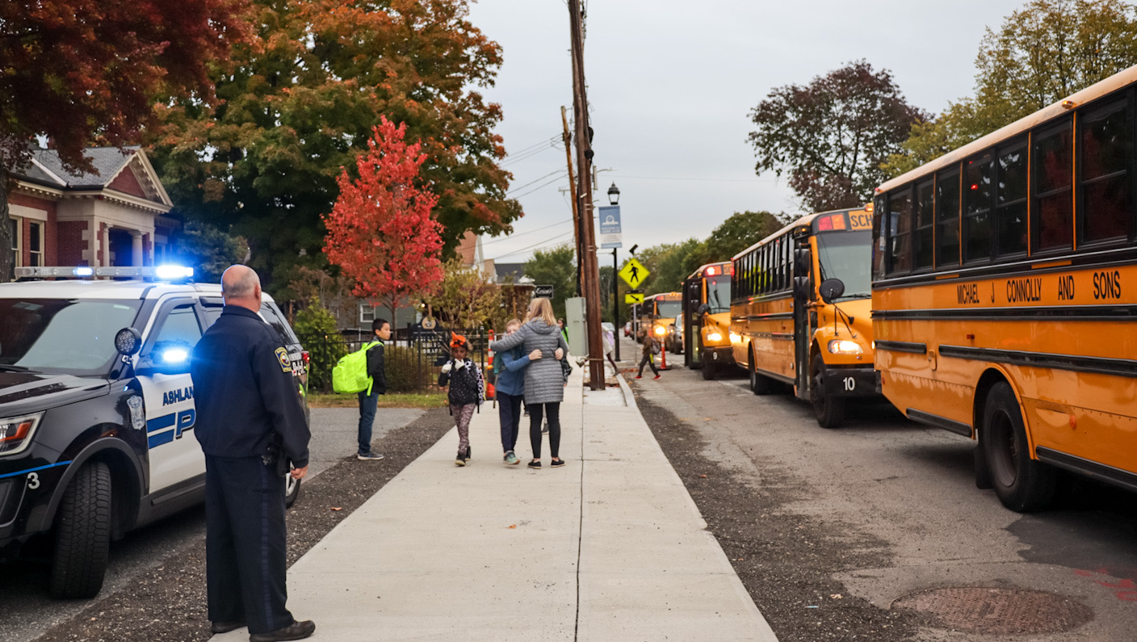
TOWN OF ASHLAND BUDGET PRESENTATION
MAY 3, 2023 • TOWN MEETING
Prepared by:
Michael Herbert, Town Manager

Slide 2
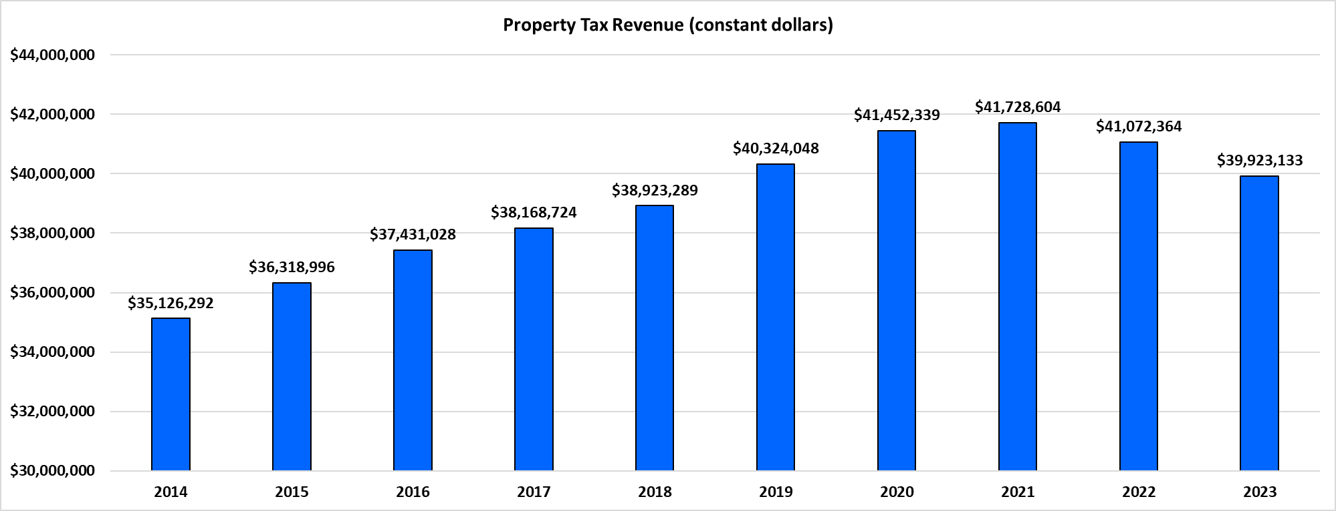
PROPERTY TAX REVENUES
Formula: Net property taxes/Consumer Price Index
Warning: A decline in property tax revenues (measured in constant dollars)
Trend: Unfavorable
Comments: The analysis shows that property tax revenue adjusted to constant dollars is negative and therefore has not kept pace with inflation.
Notes:
Inflation has had a big impact on everybody’s wallet, including the town’s. This graph shows how the purchasing power of our tax levy has decreased in the last two years, even though there was an increase in taxes the last two years.

Slide 3
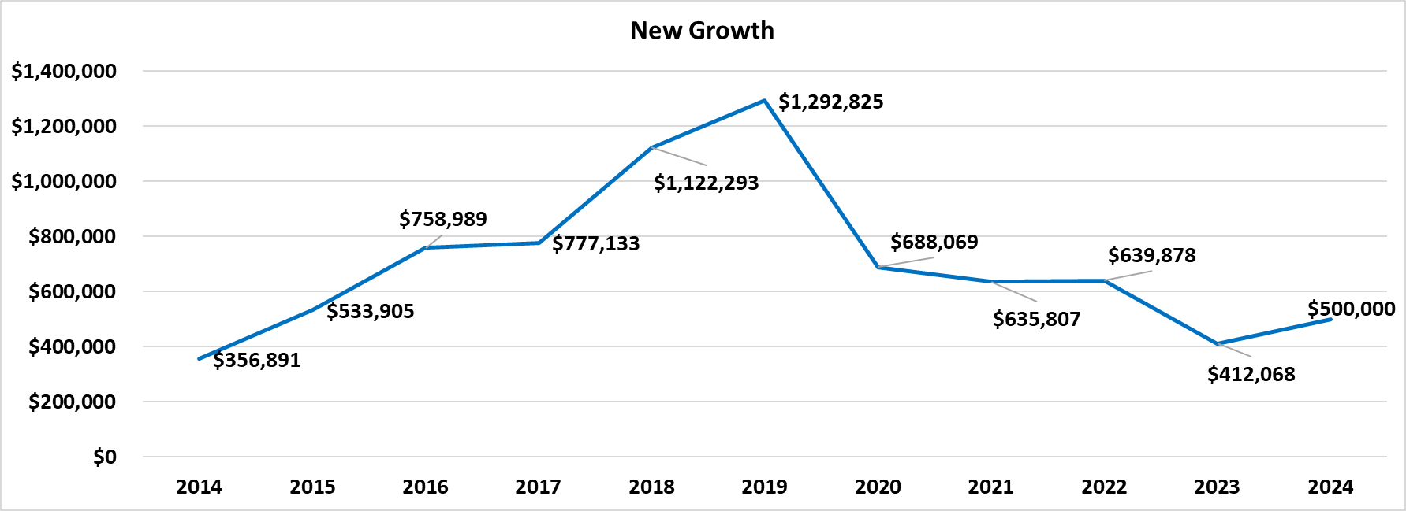
NEW GROWTH
Notes:
New growth is the amount of money added to the existing property tax levy upon completion of new developments or additions and renovations to your property. In the last 30-40 years, Ashland has heavily relied on new developments, and subsequently the revenue from those developments, to help keep the tax burden down for existing property owners. In the early 2000’s the Town’s enjoyed large new growth revenue due to larger sprawling subdivision developments such as Apple Ridge. After a decrease in revenue due to the Great Recession, new growth revenue picked up again due to multifamily developments. However, we implemented a “slow growth” policy purchasing a lot of property to protect against development.

Slide 4
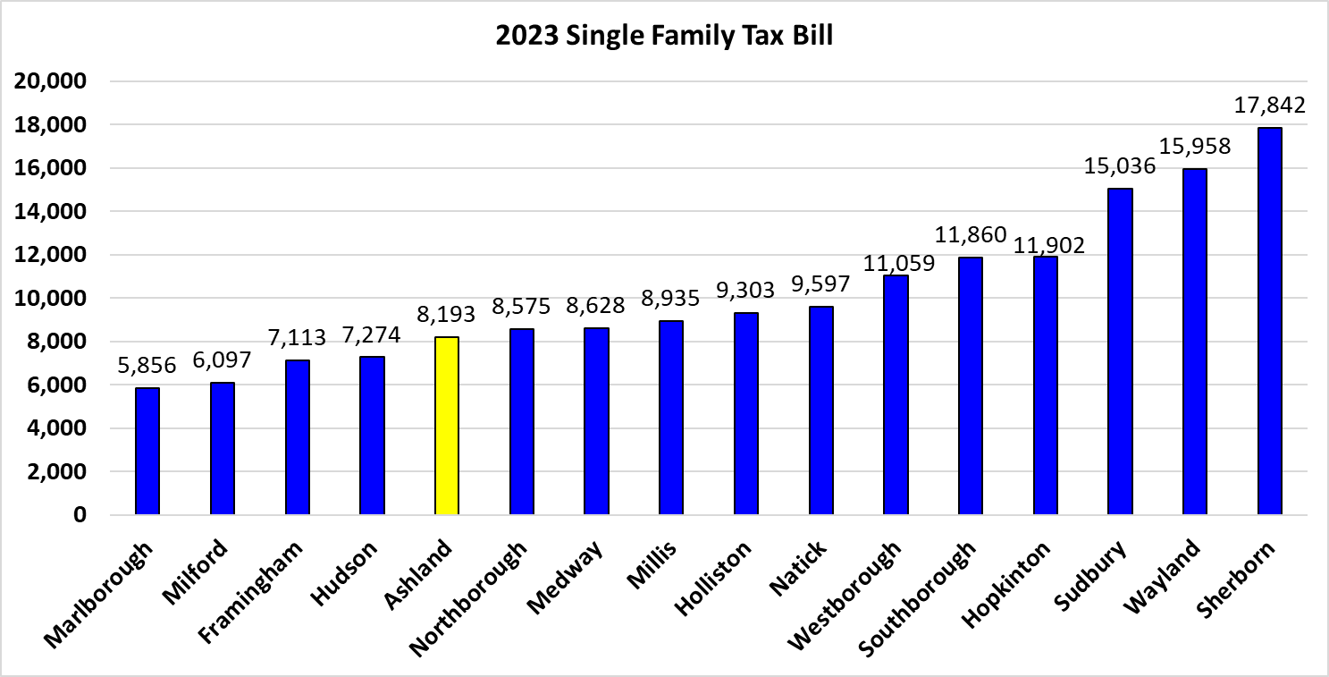
COMPARISON OF PROPERTY TAX BILLS
Notes:
I have never met someone who likes taxes. But when we analyze property taxes, we need to look at them in a regional context because we are all purchasing the same goods and services, utilizing the same contractors, and competing for the same personnel with our neighbors. Every budget that I have presented has been designed to keep our tax bill in the bottom half of those peer communities. So far that has worked, as we are fifth from the bottom when compared to 17 other communities.

Slide 5
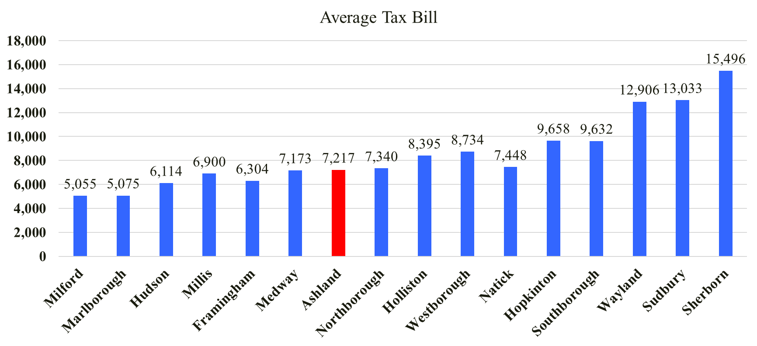
COMPARISON OF PROPERTY TAX BILLS
*Note: Tax Bill comparison from approximately 6 years ago – FY17.

Slide 6
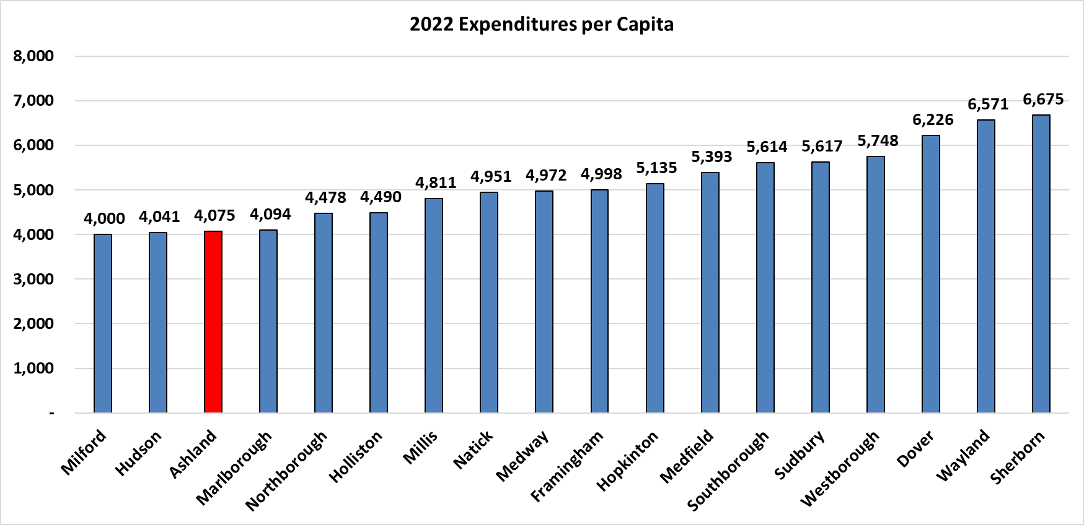
EXPENDITURES PER CAPITA
Note: If all of Ashland’s FY24 requests were included in the FY24 budget, the expenditures per capita
would be $4,942. Comparing Ashland’s FY24 budget with all requests to surrounding communities 2022 Expenditures per capita, Ashland is still on the lower end of the scale.
Notes:
Comparing these communities based on the overall size of their budget because it doesn’t take into account disparities between them like population and state aid. So I proposed that we utilize expenditures per capita to be a more apples-to-apples approach to measure our spending. Our goal is to keep this figure on the lower half, although we have to understand that means less investment in services and infrastructure.

Slide 7
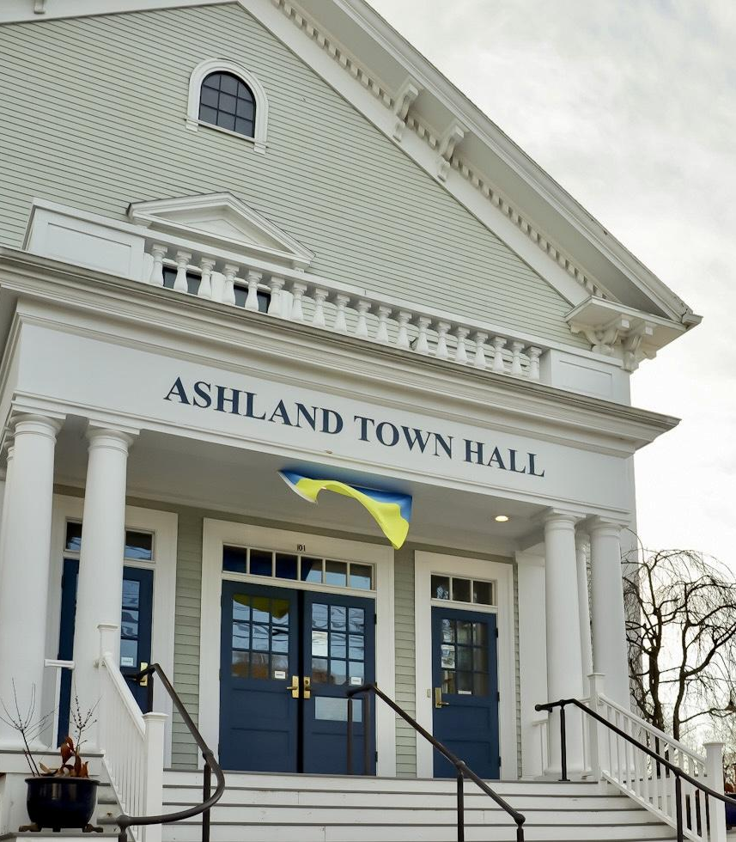
GENERAL FUND OVERVIEW
Notes:
Overall, the General Fund budget increases $4.5 million or 6.2%

Slide 8
GENERAL FUND OVERVIEW

Slide 9
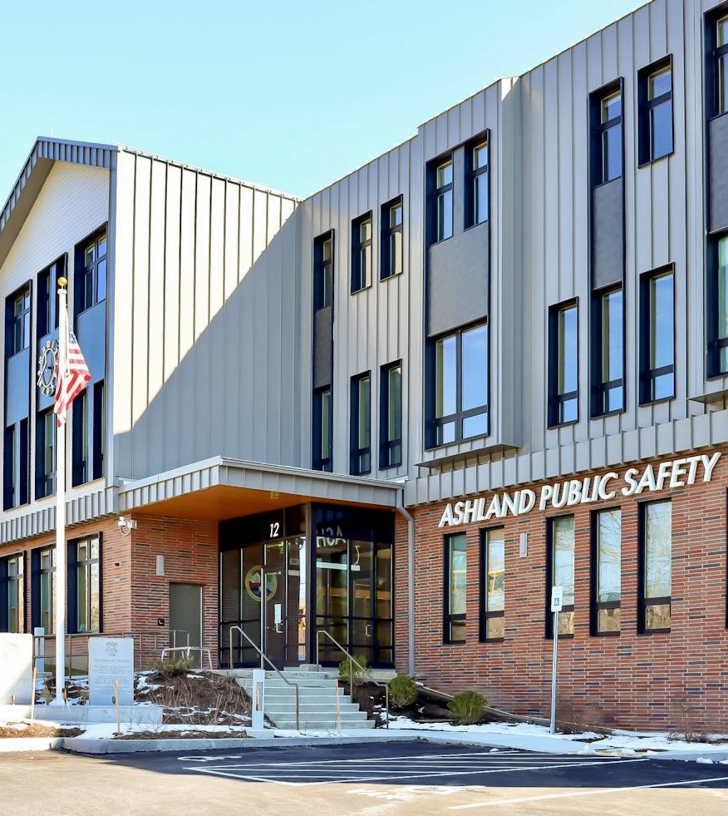
ADDITIONS TO BUDGET
DEPARTMENT | POSITION | AMOUNT | DESCRIPTION
Conservation | Part-time Conservation Agent | $15,600 | Ability for existing ConCom Agent to expand duties.
Health | Nursing Services | $28,000 | Enhanced ability to offer vaccine clinics and do more prevention work.
Library | Library Assistant | $20,129 | As FAPL moves away from doing programming, this allows us to take on more of that role.
Recreation | Assistant Director | $51,156 | Better planning for future recreation needs. Potential of a Parks and Rec department. Work on larger projects such as GS property. Funded through revolving account.
Building | PT Building Inspector | $48,880 | Will take on some of the existing work of the Building Commissioner so the Commissioner can focus on capital projects.
Public Works | Business Manager | $40,000 (GF) | Addition of DPW Business Manager would allow Director to spend more time on oversight and long-term planning for infrastructure
Notes:
We have been able to cut expenses in some areas to make funding available for current needs.

Slide 10
UNFUNDED NEEDS FOR FY’24
TOWN OF ASHLAND
DEPARTMENT | ITEM/POSITION | AMOUNT | SERVICES AFFECTED
Planning | Staff Planner | $60,000 | Planning will continue to focus on transactional issues. Reduced ability to do proper long-term planning, especially related to MBTA Communities. Projects in front of PB and ZBA won't receive the proper support given the anticipated volume.
Information Technology (.5) | Data Specialist | $30,000 | Inability to maintain data accuracy, integrity, and consistency across multiple platforms in all departments (including APS).
Fire | Firefighters (4) | $242,672 | Reduced ability to manage simultaneous third call; increased reliance on mutual aid
Police (existing funded positions) | Police Officers (2) | $120,000 | Reduction will eliminate the possibility of filling all specialty positions with FT personnel, such as Detectives and SRO's.
Finance Director (existing position) | Senior Accountant/Financial Analyst | $70,000 | Reduced ability to perform financial/data analysis to improve decision-making. Less consistent oversight of town infrastructure projects. To reduce some of the impact of this, we would expand the scope of the existing AtoTA position and include Business Mgr in DPW.
Library | Library Assistant - Marketing | $202,019 | Inability to expand marketing efforts; existing work will be done by current staff.
Library | Library Assistant - Children's | $18,905 | If converting Children's Library to Asst. Director position, will lose some children's programming in Library.
Facilities (existing funding position) | Capital and Procurement Specialist | $80,000 | Current projects will not receive proper amount of oversight. Inability to take on new initiatives. To help address some of this, we are giving some responsibility to the current Bldg Commissioner and funding PT Building Inspector
Public Works | Contracted Services | $50,000 | Will not be able to keep up with basic tasks such as mowing and maintenance, tree work, etc.
Public Works | Property & Trail Maintenance | $30,000 | Decreased ability to maintain trails and open spaces.
Salary Contingency |  | $225,000 | Exacerbated gap between current salaries and market. Inability to recruit and retain quality personnel even for existing positions, leading to further burnout.
Notes:
There are a number of needs to the dfnndf h

