Slide 1
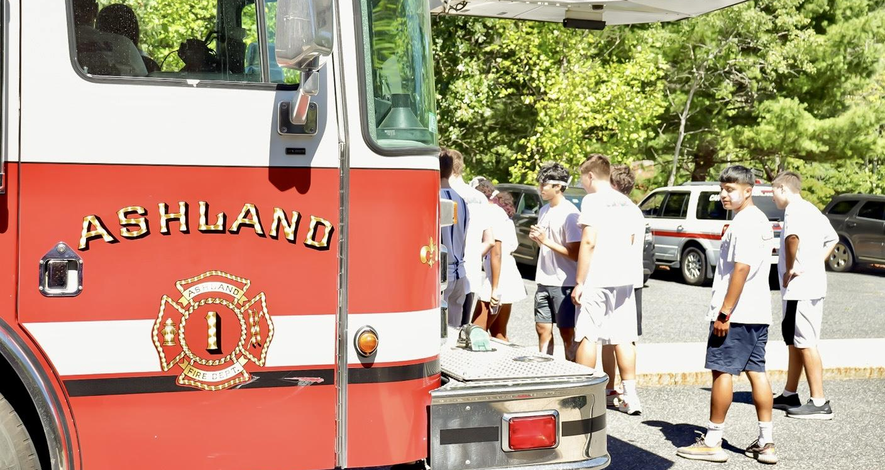
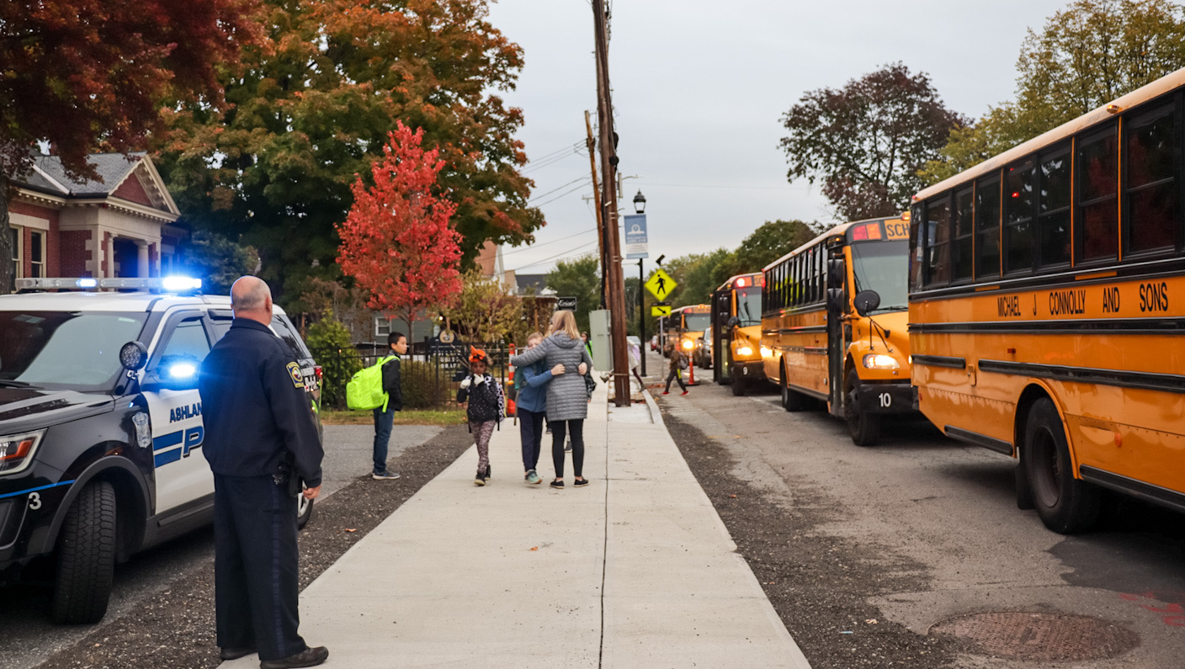
TOWN OF ASHLAND PROJECT UPDATE
MAY 3, 2023 • TOWN MEETING
:

Slide 2
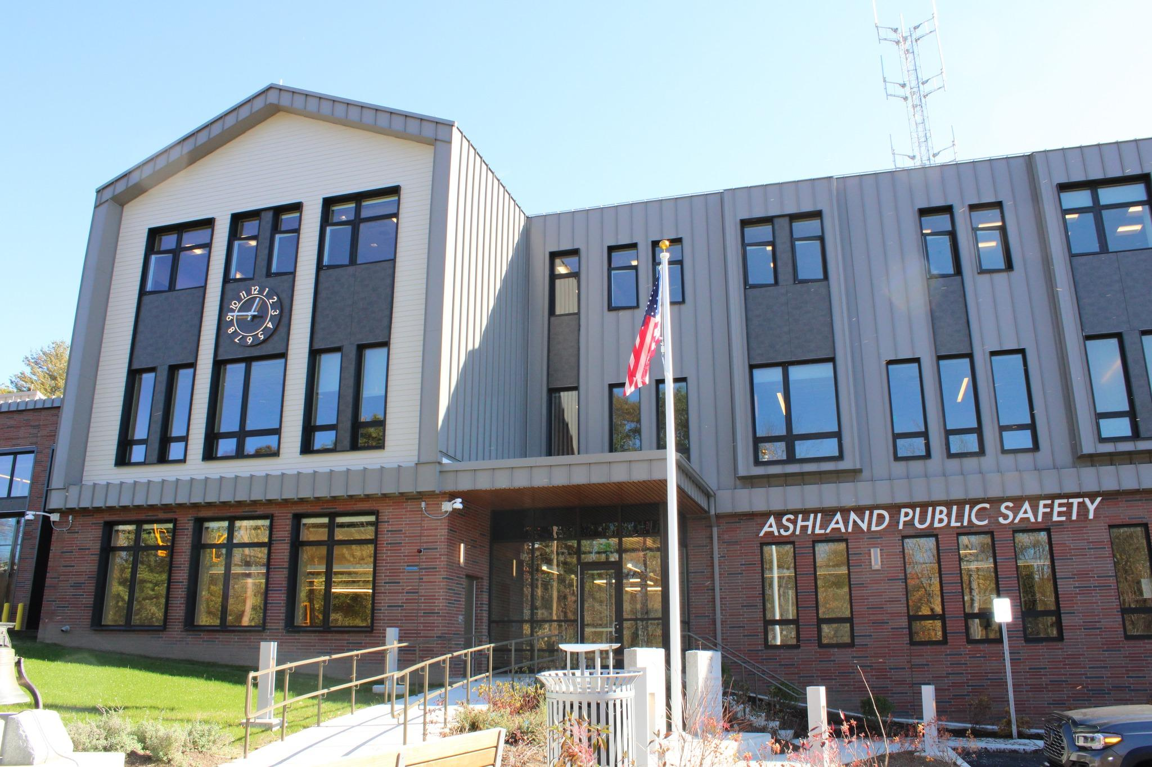
Alexa Vega
PUBLIC SAFETY BUILDING
Substantially completed spring 2023
Police have moved; Fire in the process of moving
Open house tentatively scheduled for June

Slide 3
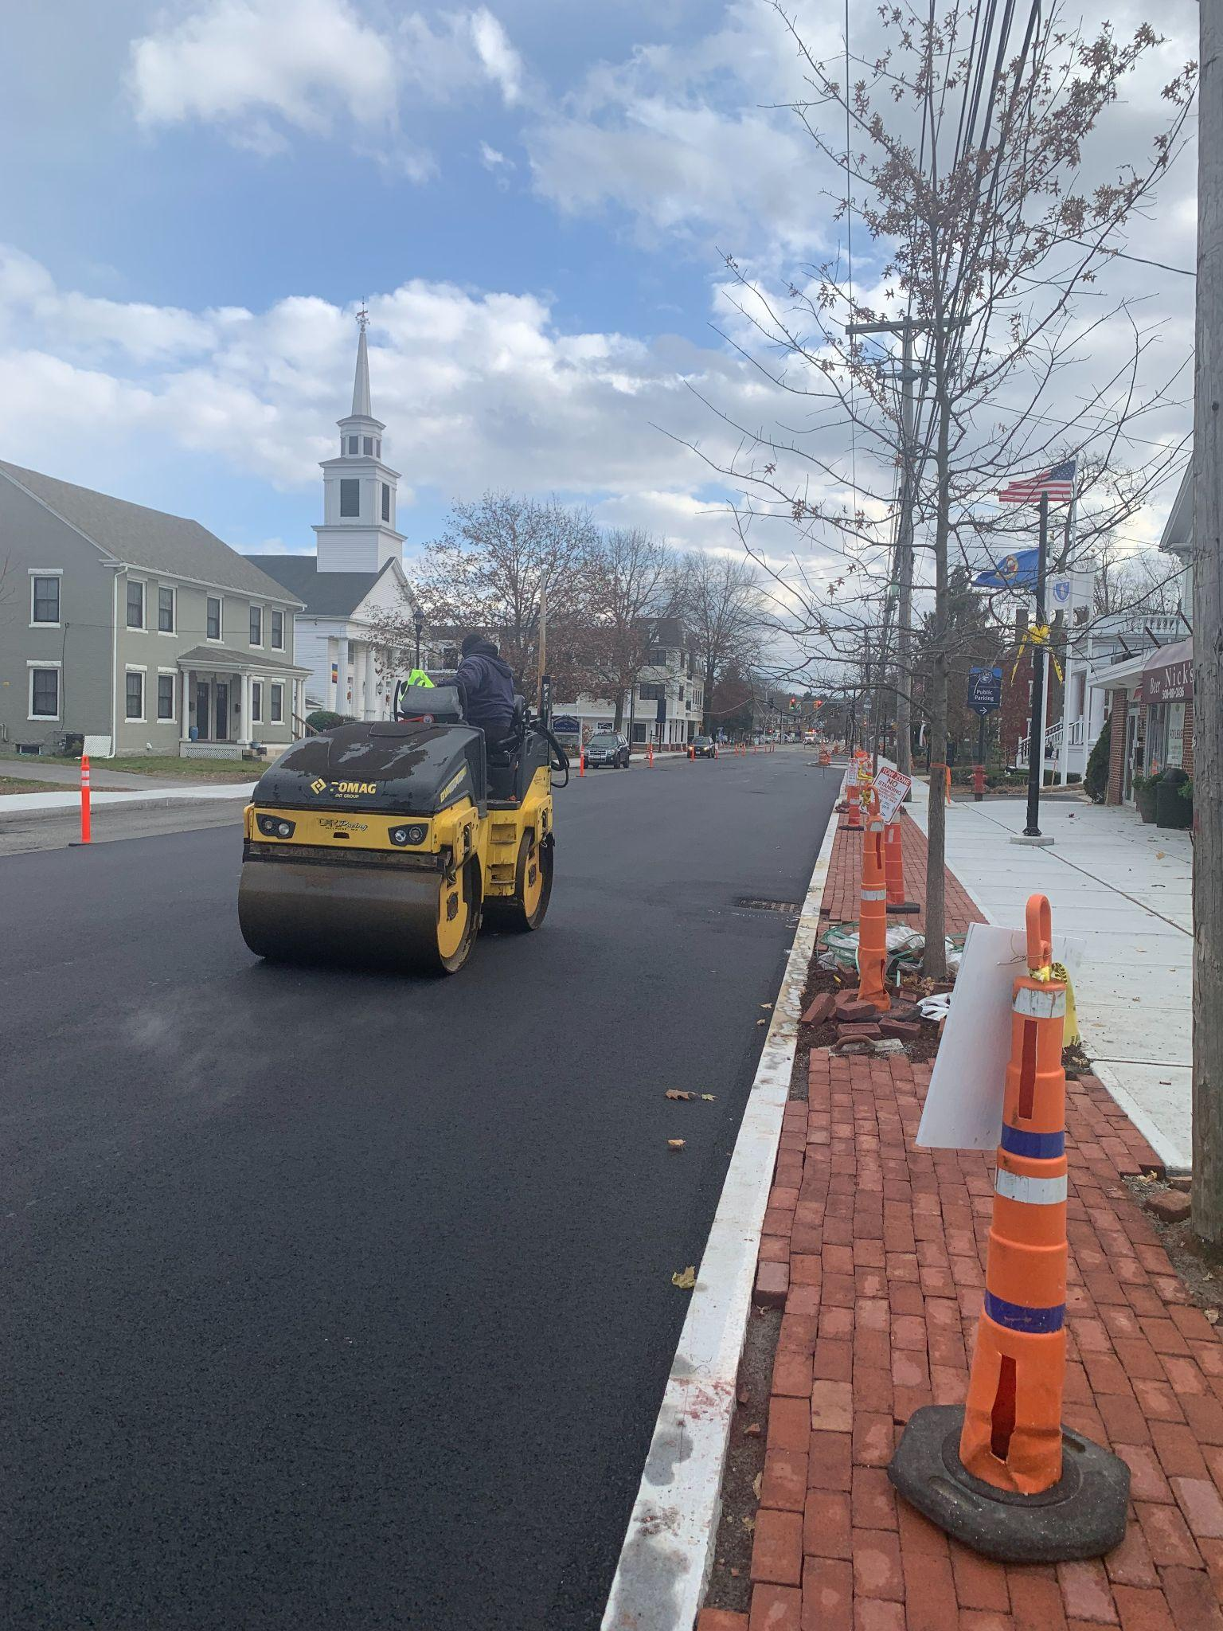
Alexa Vega
DOWNTOWN PROJECT
100% of underground infrastructure completed
Curbing/Sidewalk/Paving is 90% completed
Utility companies are currently installing equipment and cable underground
Next phase is to connect utilities to buildings
Final action is to remove poles (dependent on Eversource)

Slide 4
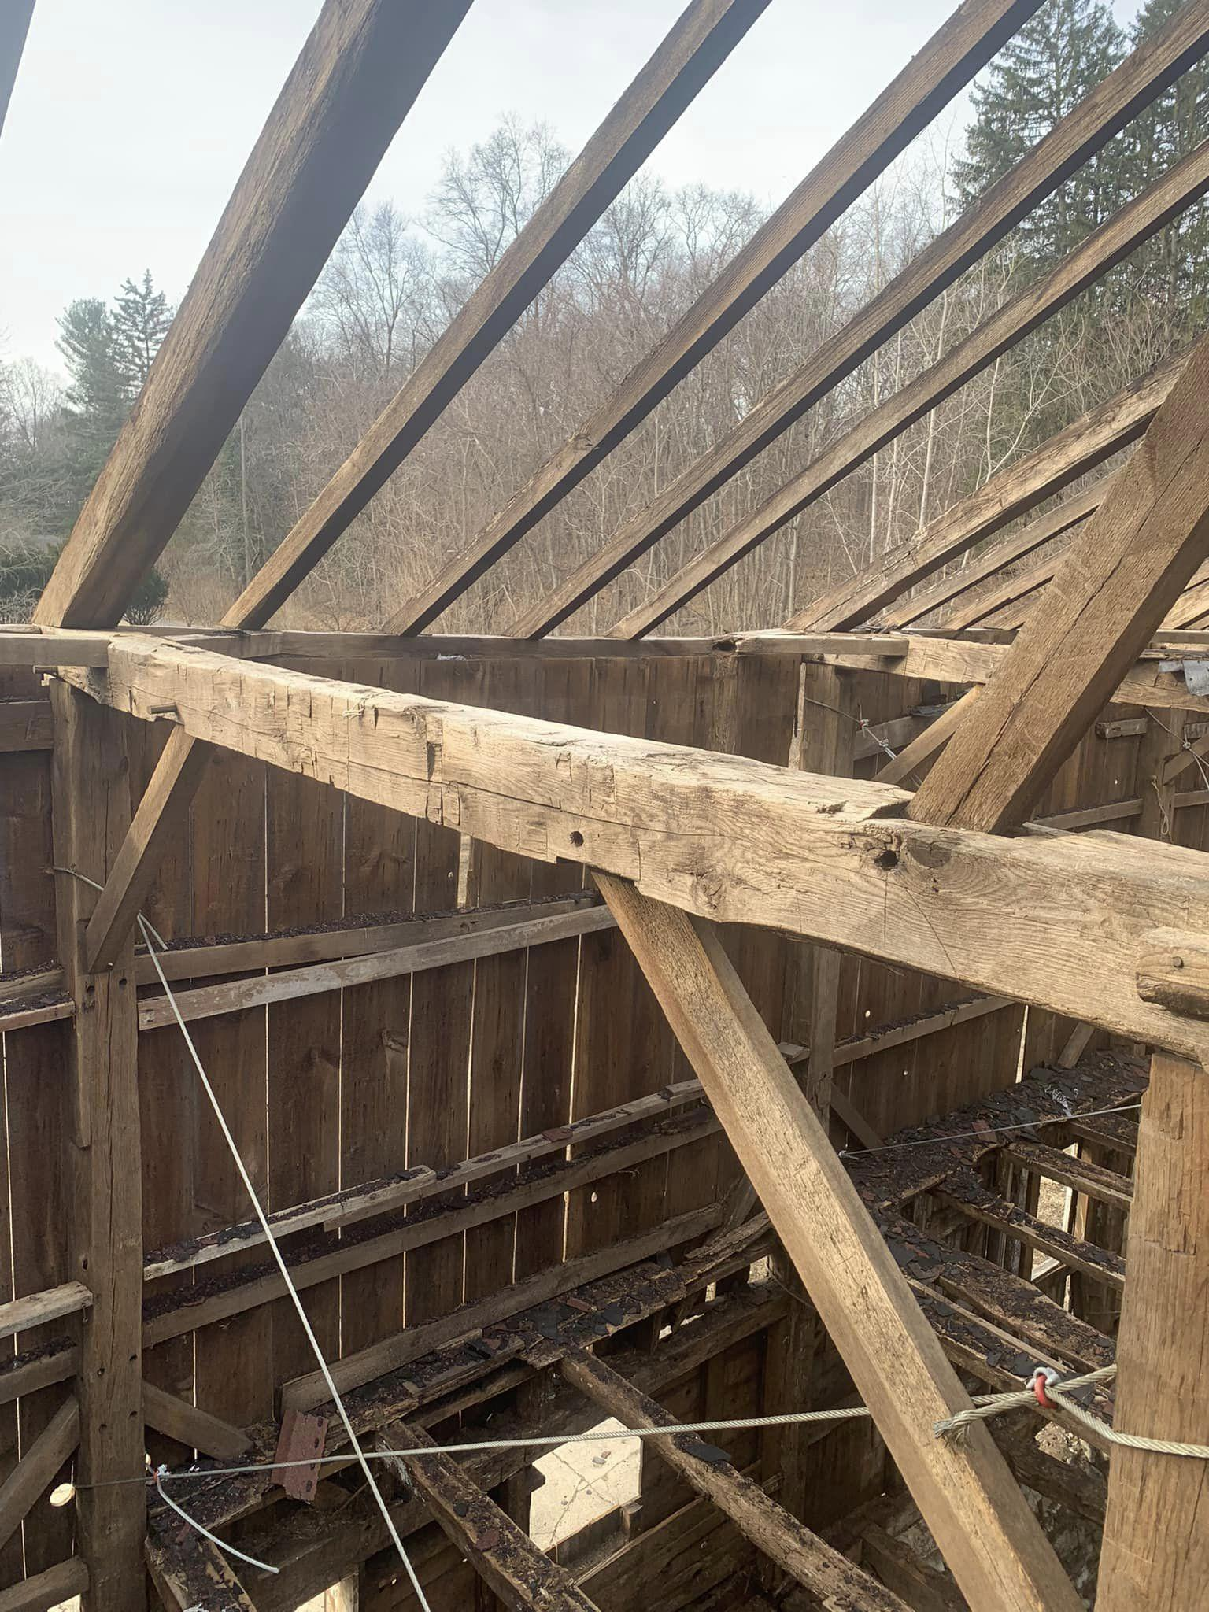
VALENTINE ESTATE
Currently undergoing $1 million renovation of barn
Engaged in discussions with potential Conservation Restriction holder

Slide 5
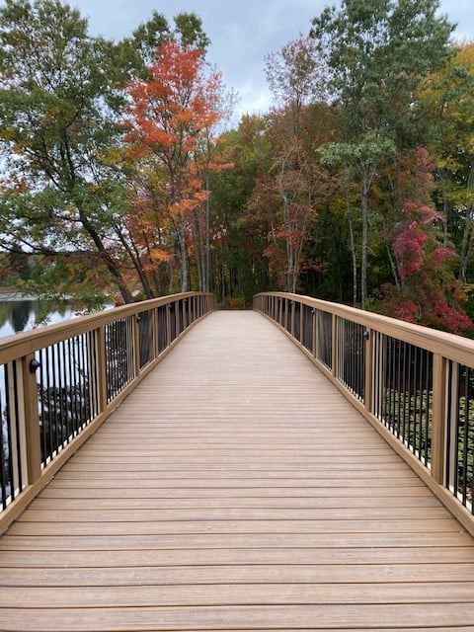
COMPREHENSIVE PLAN
Steering Committee is almost 100% constituted
Received 3 proposals from consultants

Slide 6
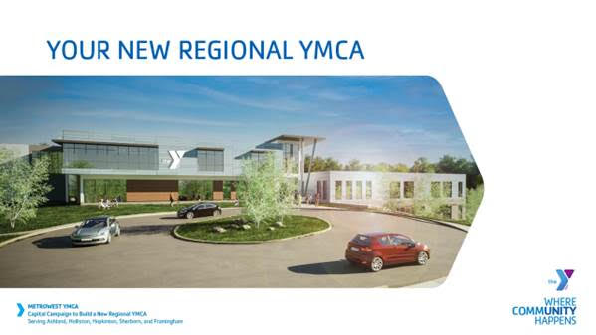
REGIONAL YMCA ASHLAND
$20 Million Capital Campaign Kicked off
$2.5 Million Donation from MathWorks
Construction begins when capital campaign raises 70%
Construction typically takes one year

