Slide 1

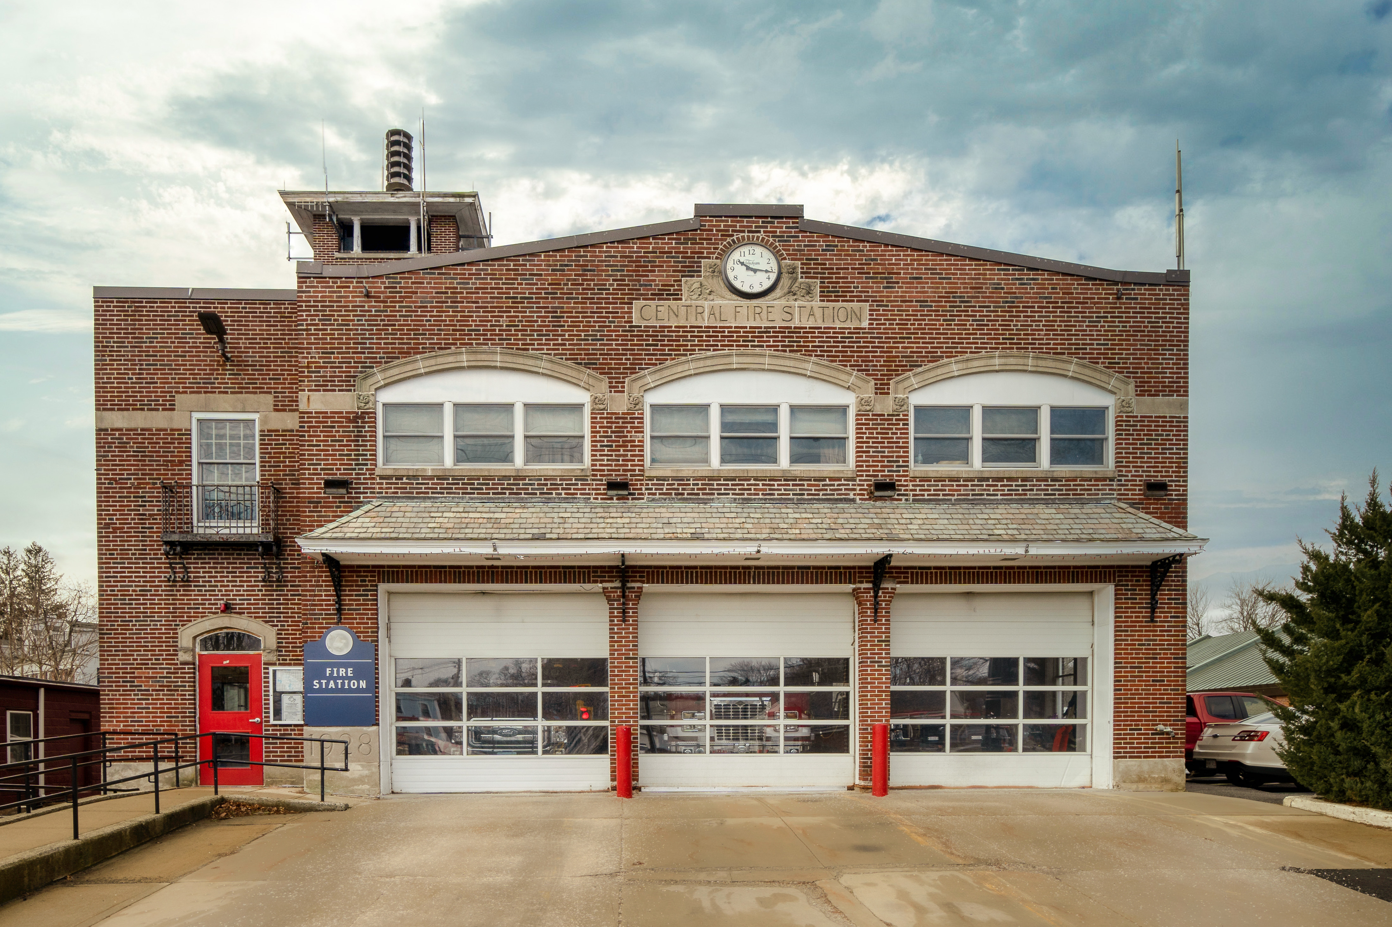
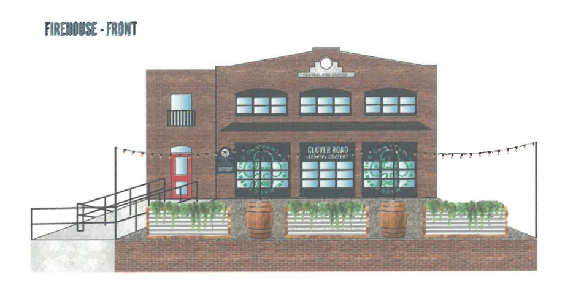
The future USE THE FIRE STATION Request for proposal (RFP)
151 Main street, Ashland ma 01721

Slide 2
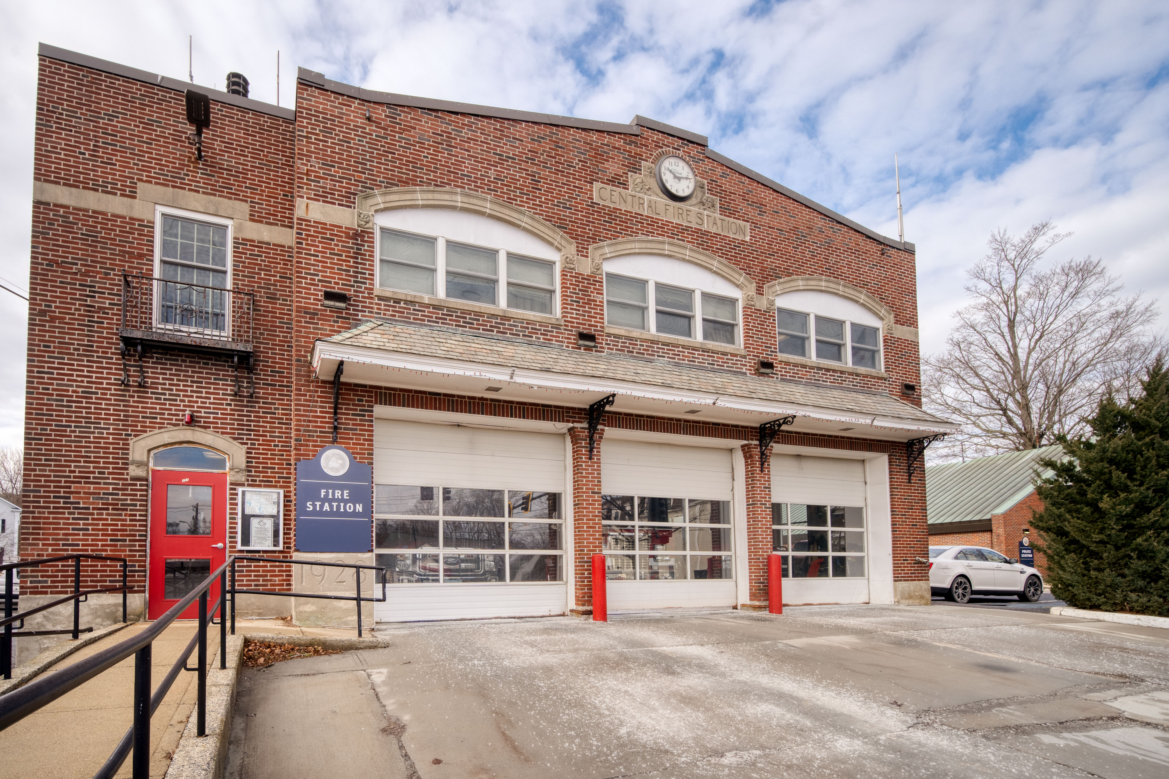
PROCESS
In anticipation of the opening of the new Public Safety Building, the Town explored reuse options
A Request for Interest (RFI) was advertised to the public to gather information on what type of interest there was for private sector investment
Fall of 2022, a RFI, limited to commercial use and required the preservation of the fire station façade, was issued. Responses were due December 6th
A Public Forum was held January 25th 2023 where the concepts from 3 interested parties were presented, including the Clover Road taproom.
To gather additional information from the community, a survey was created. Over 400 responses were acquired. The survey results showed clearly that the town preferred a lease over sale and supported a brewery or restaurant in this location.
A formal Request for Proposals for the lease of the fire station was issued February 16th. Responses were due on March 30, 2023
The Town received one proposal from Clover Road Brewing for a brewery taproom.

Slide 3
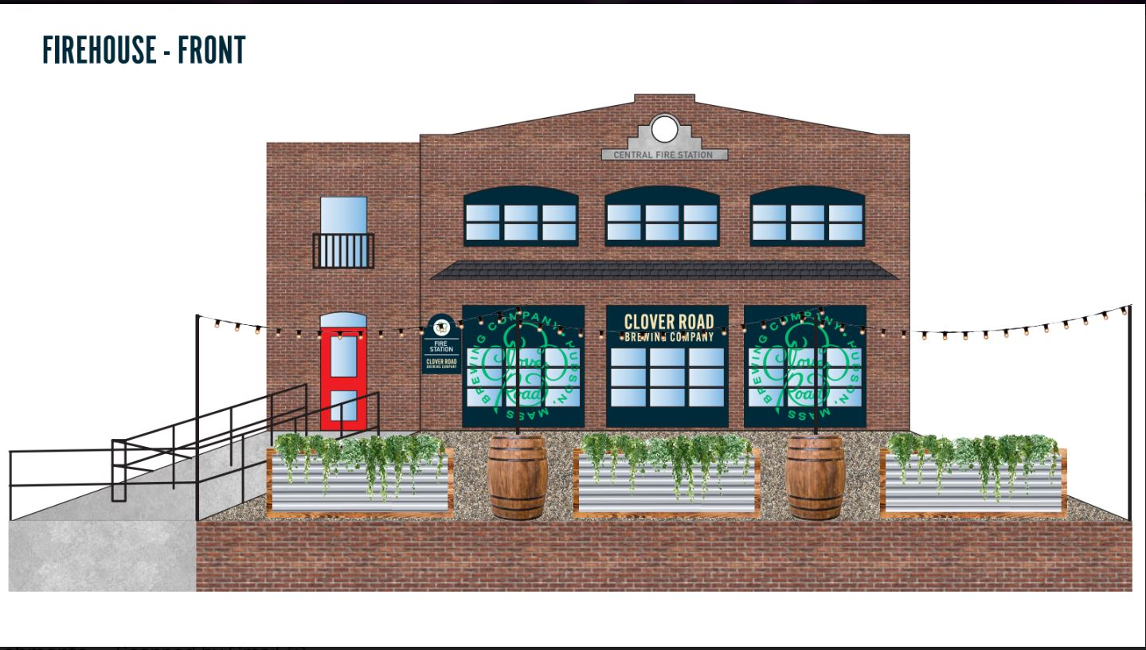
Proposal Summary
Proposal: Clover Road Brewery - Taproom
Existing brewery in Hudson, MA
Looking for additional space to sell product and create community space in Ashland.
70 Seats total, includes indoor space and outdoor patio
Cornhole and games, private events and community gathering space
Encourages community involvement through running clubs, trivia, movie and comedy nights
What it will bring:
Tap Room, Food Trucks, Music & Entertainment
Vibrancy in Downtown
Attraction to encourage visitors and potential business for other existing businesses in downtown
Conceptual Renderings
(Not Final Design as the
permitting process is still needed )

Slide 4
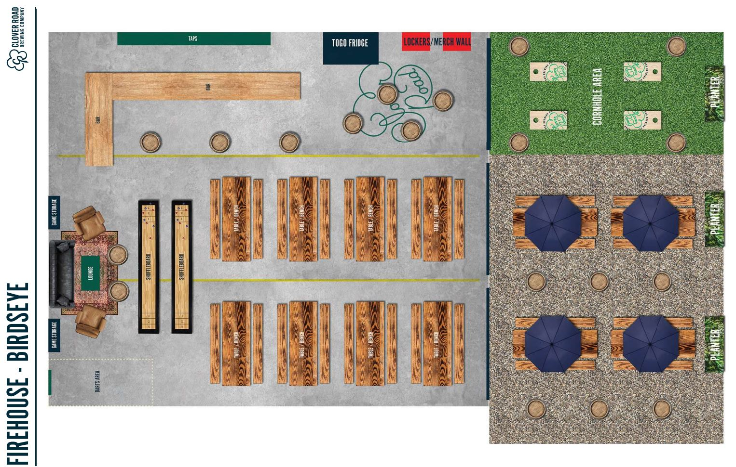
CONCEPT Rendering of INSIDE

