Slide 1

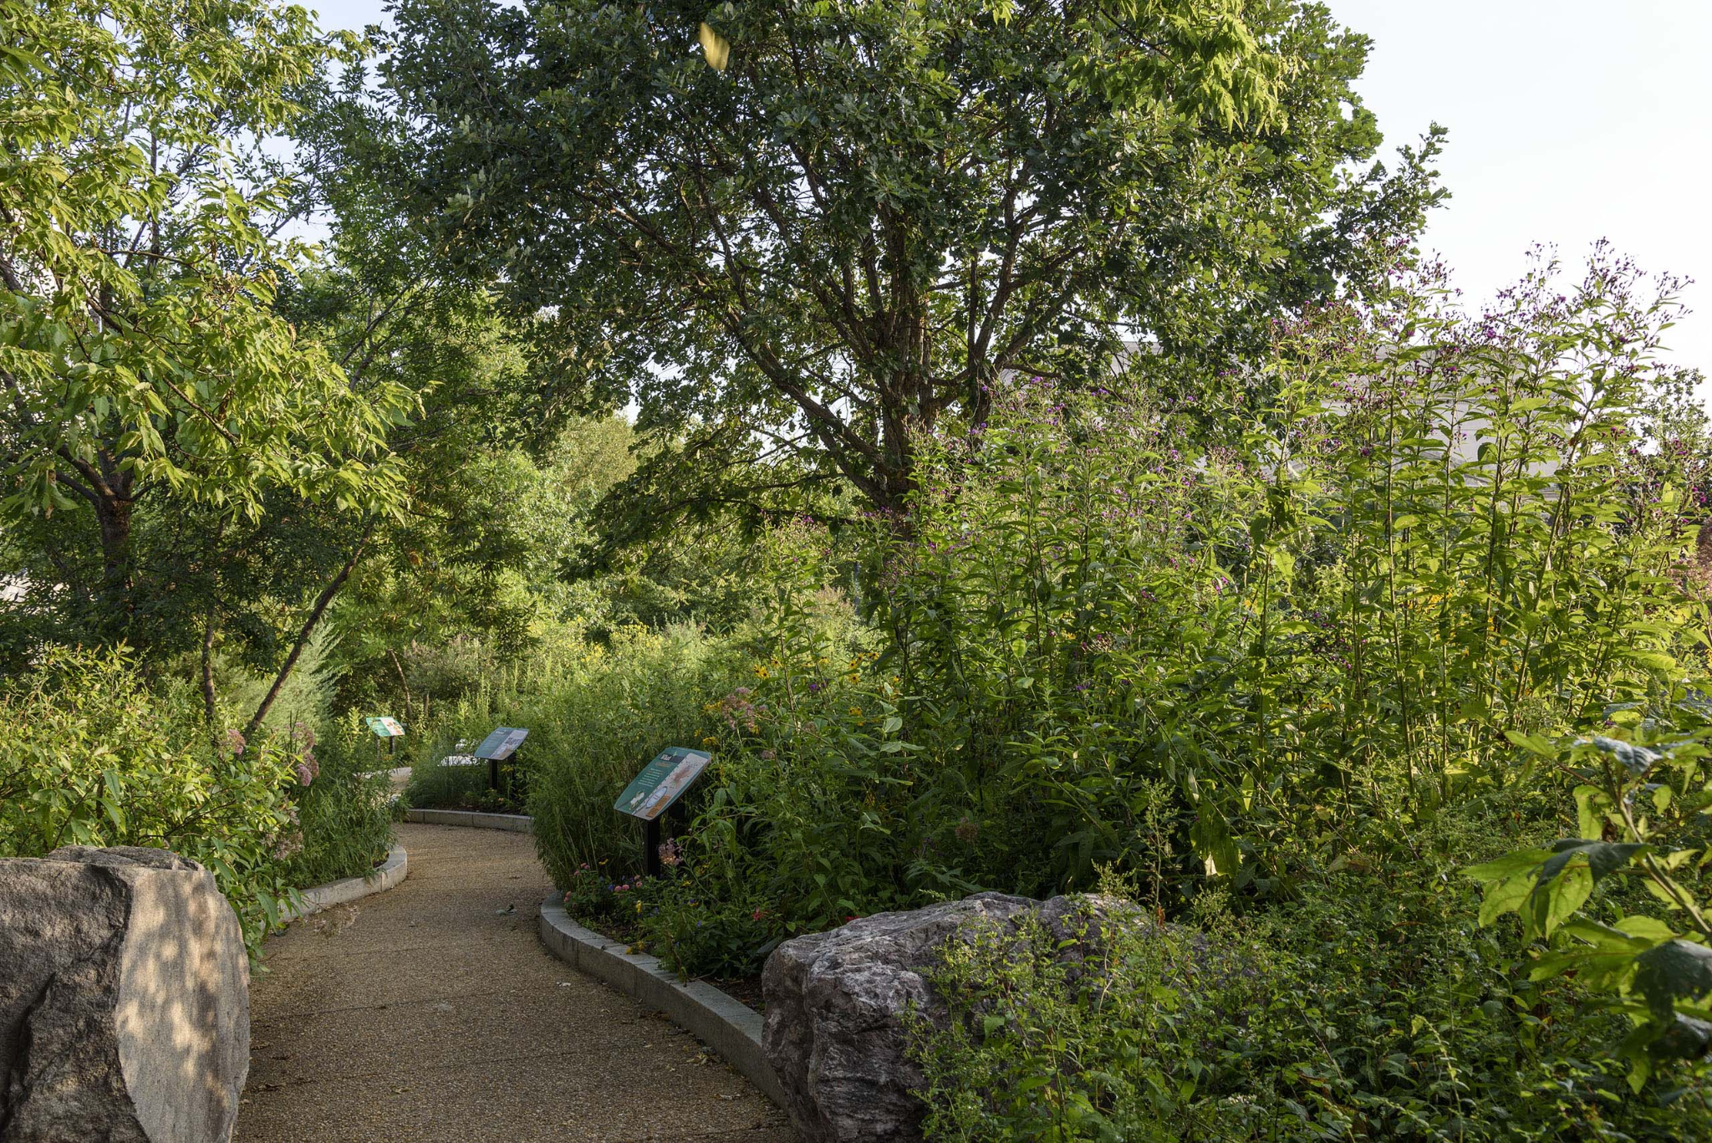
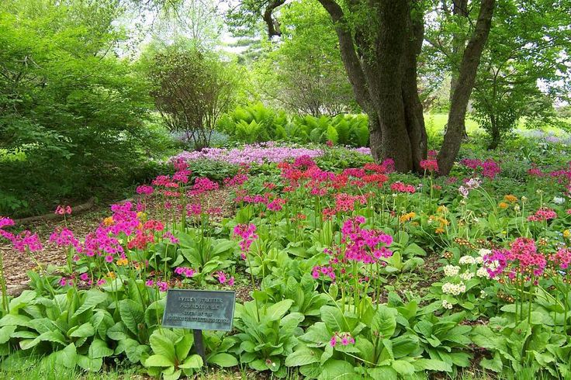
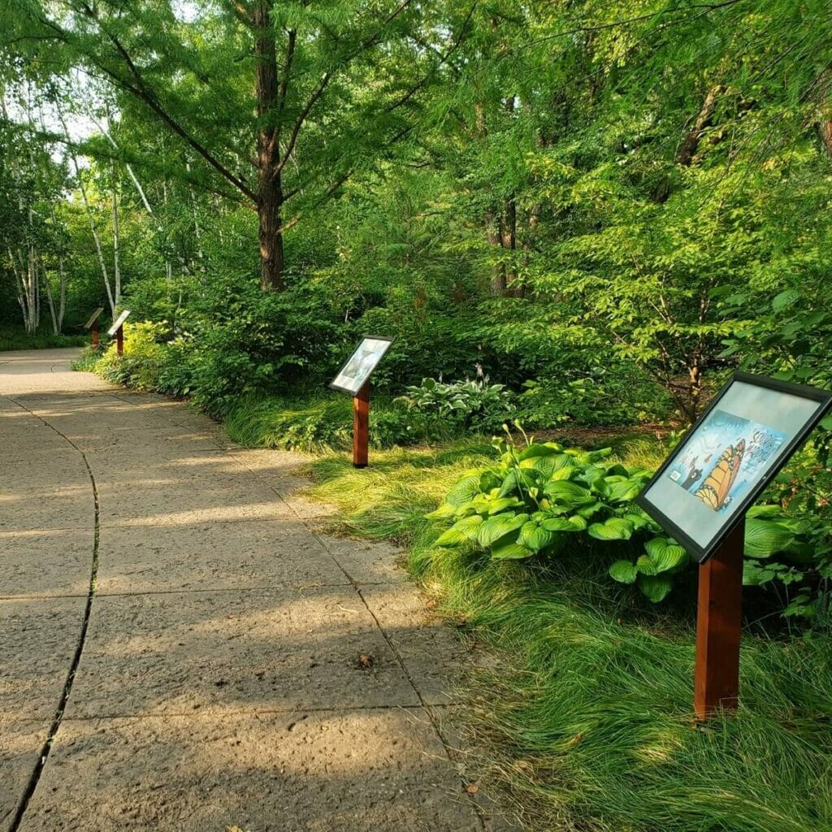
Ashland Arboretum
Proposed project at the Cadillac Paint site located at 409 Eliot Street.

Slide 2
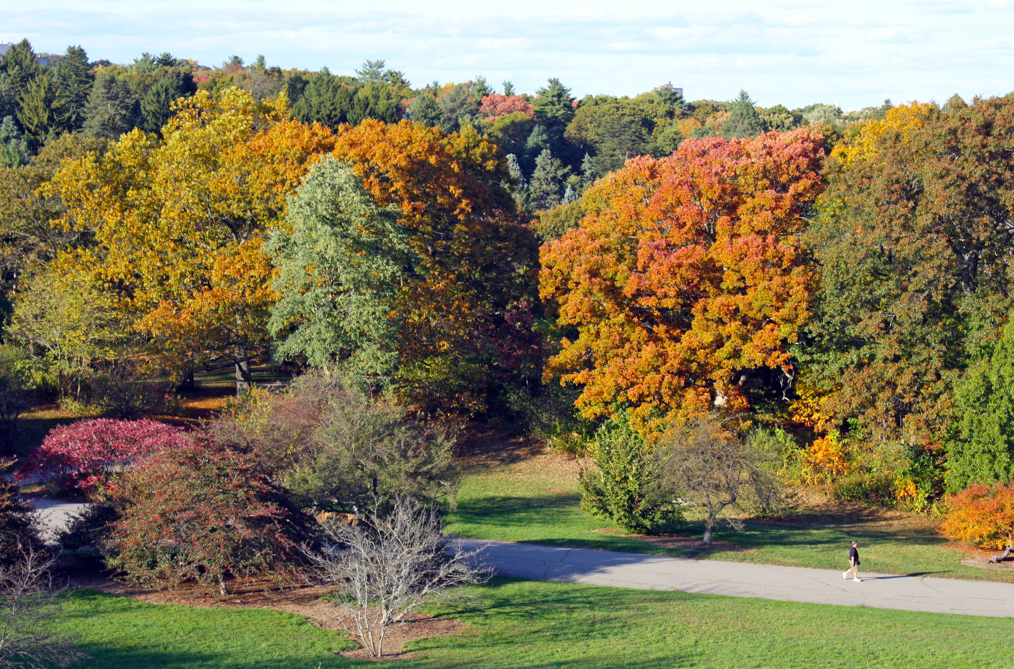
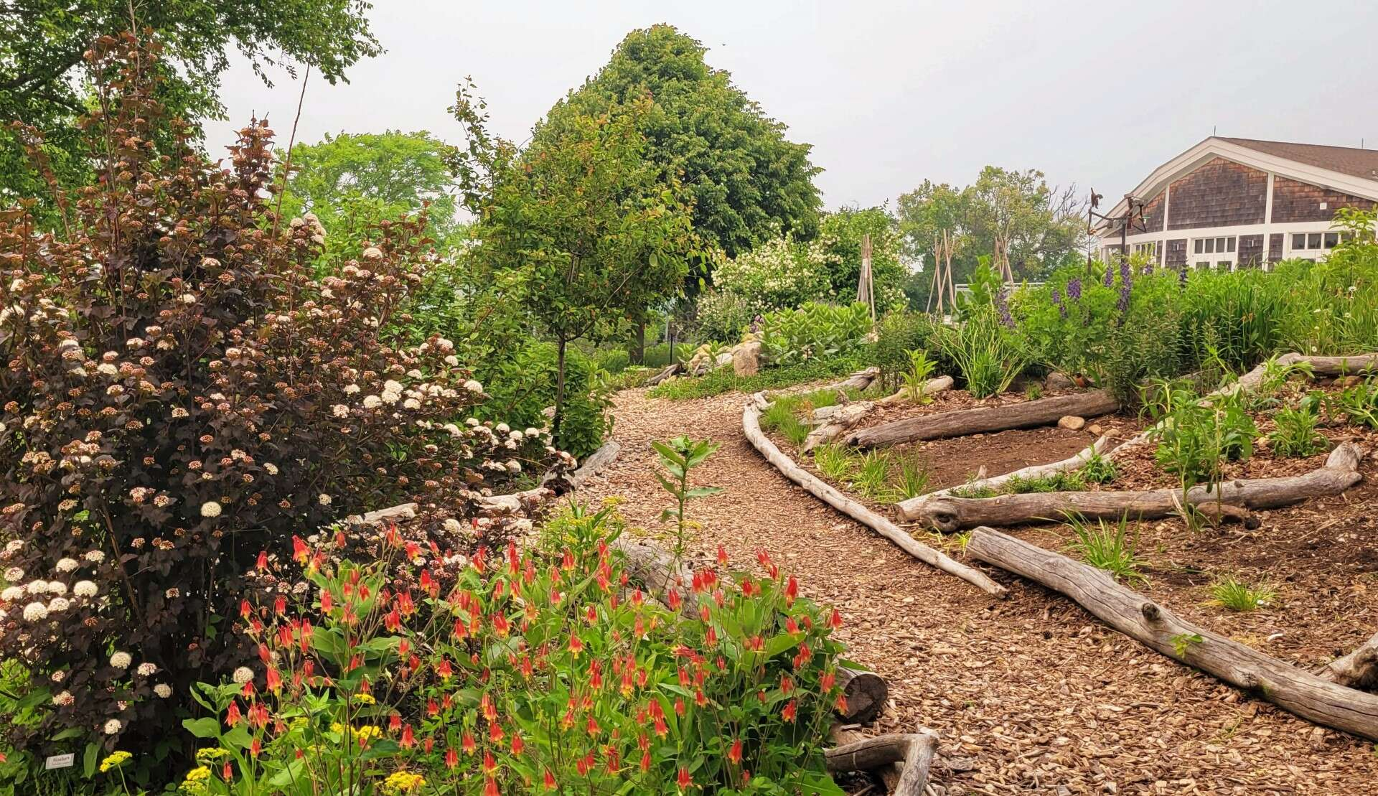
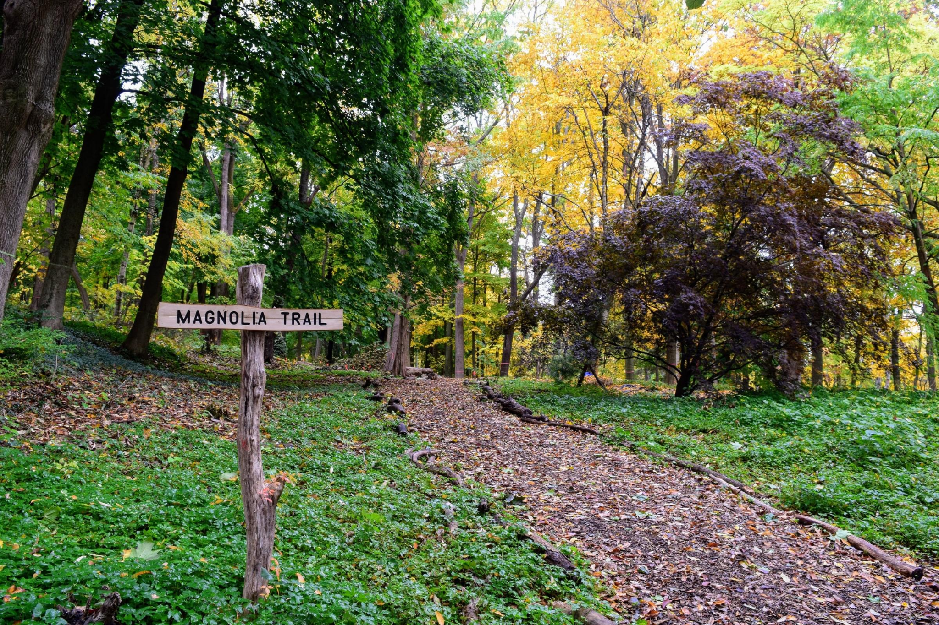
What is an Arboretum?
Is defined as “a place where trees, shrubs and herbaceous plants are cultivated for scientific and educational purposes”
Merriam-Webster Dictionary
Source: https://www.masslive.com
Source: https://birdinghotspots.org
Source: https://www.zip06.com

Slide 3

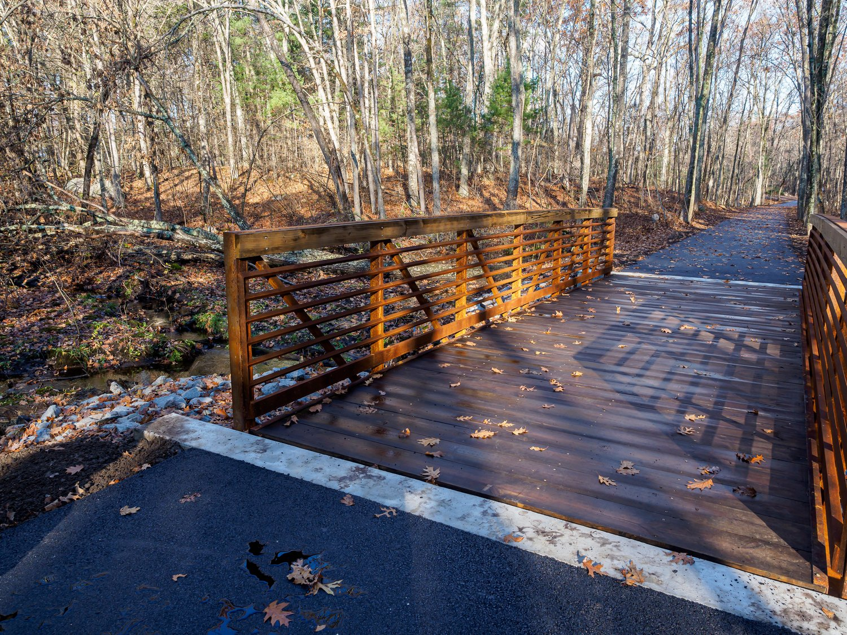
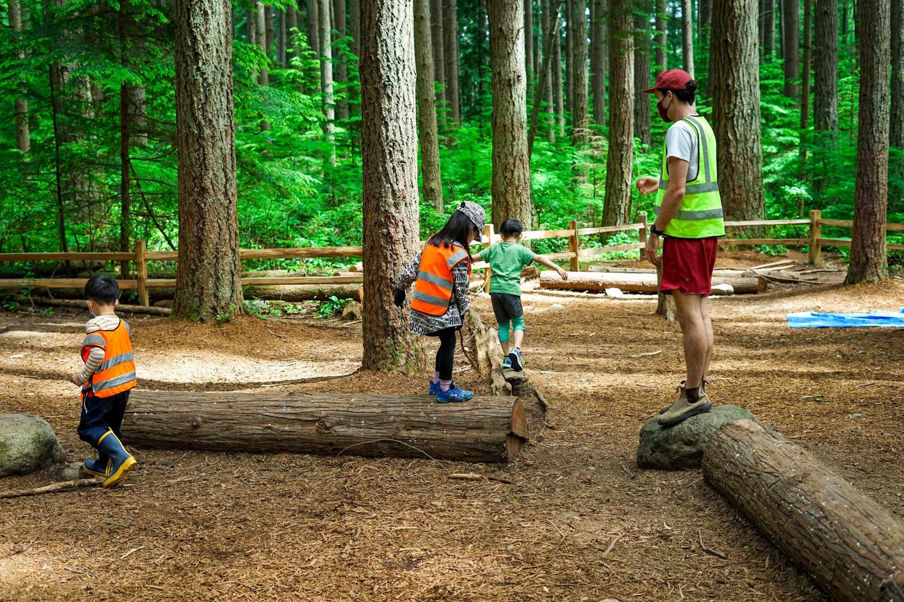
Benefits of an Arboretum
Local Educational space for the community to learn more about surrounding.
Positive environmental asset for the town.
Need to add more outdoor third spaces.

Slide 4
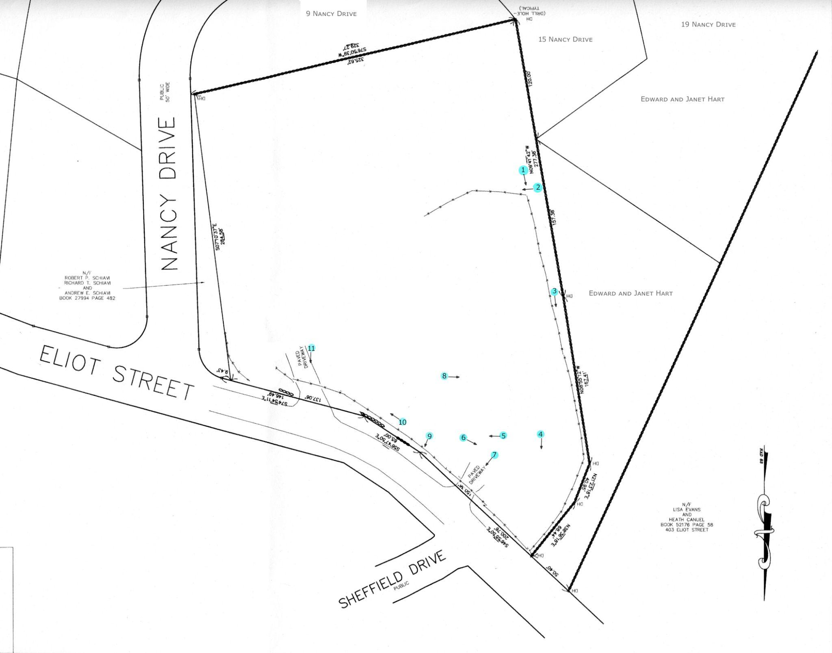
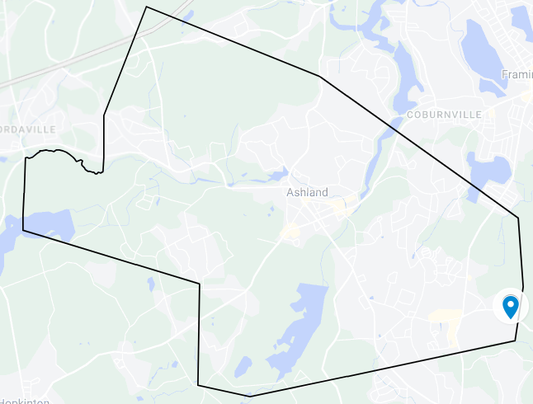
Proposed area
Previously known as “Cadillac paint”, 409 Eliot Street has gone through a transformative process.
On 2017 Ashland residents voted during the Special Town Meeting to take “Cadillac Paint” by eminent domain to remove the building and finish the remediation of the site.
In 2018 the demolition of the building occurred, and NOBIS engineering removed all the contaminants on the property and replaced it with clean soil.
After going through these transformative process the Town of Ashland would like 409 Eliot Street to go even one step further and create an arboretum in this area. This would create a new safe recreational and educational place for the residents of Ashland.

Slide 5
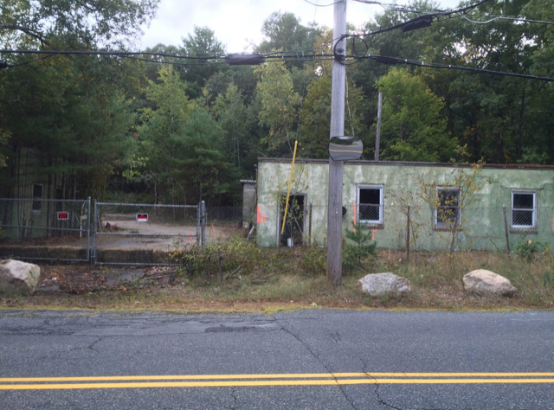
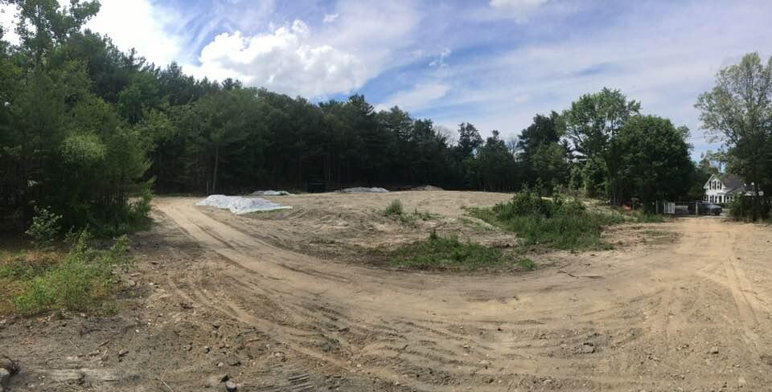
Site progress
2017
2020

Slide 6
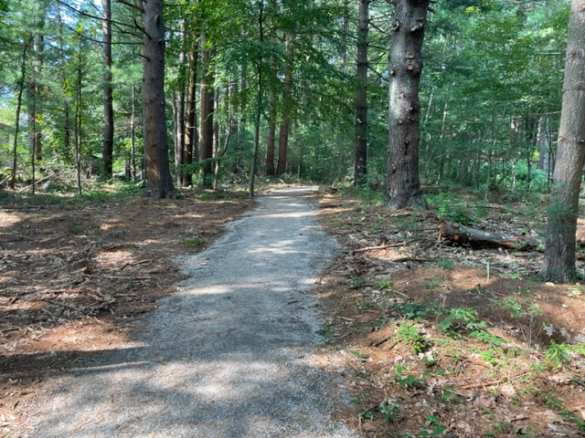
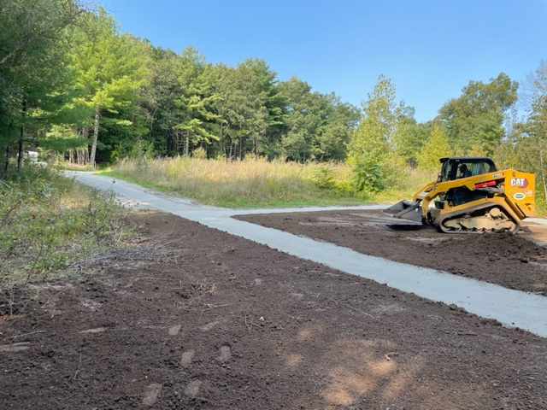
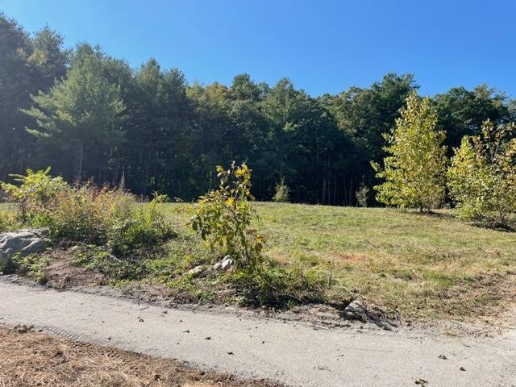
Site progress
Present (2023)

Slide 7
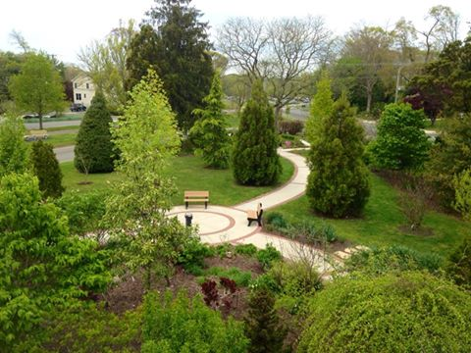
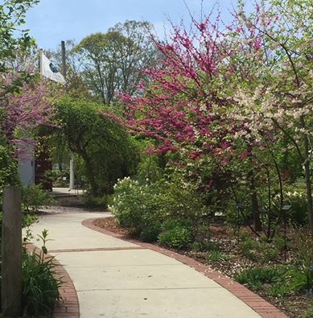
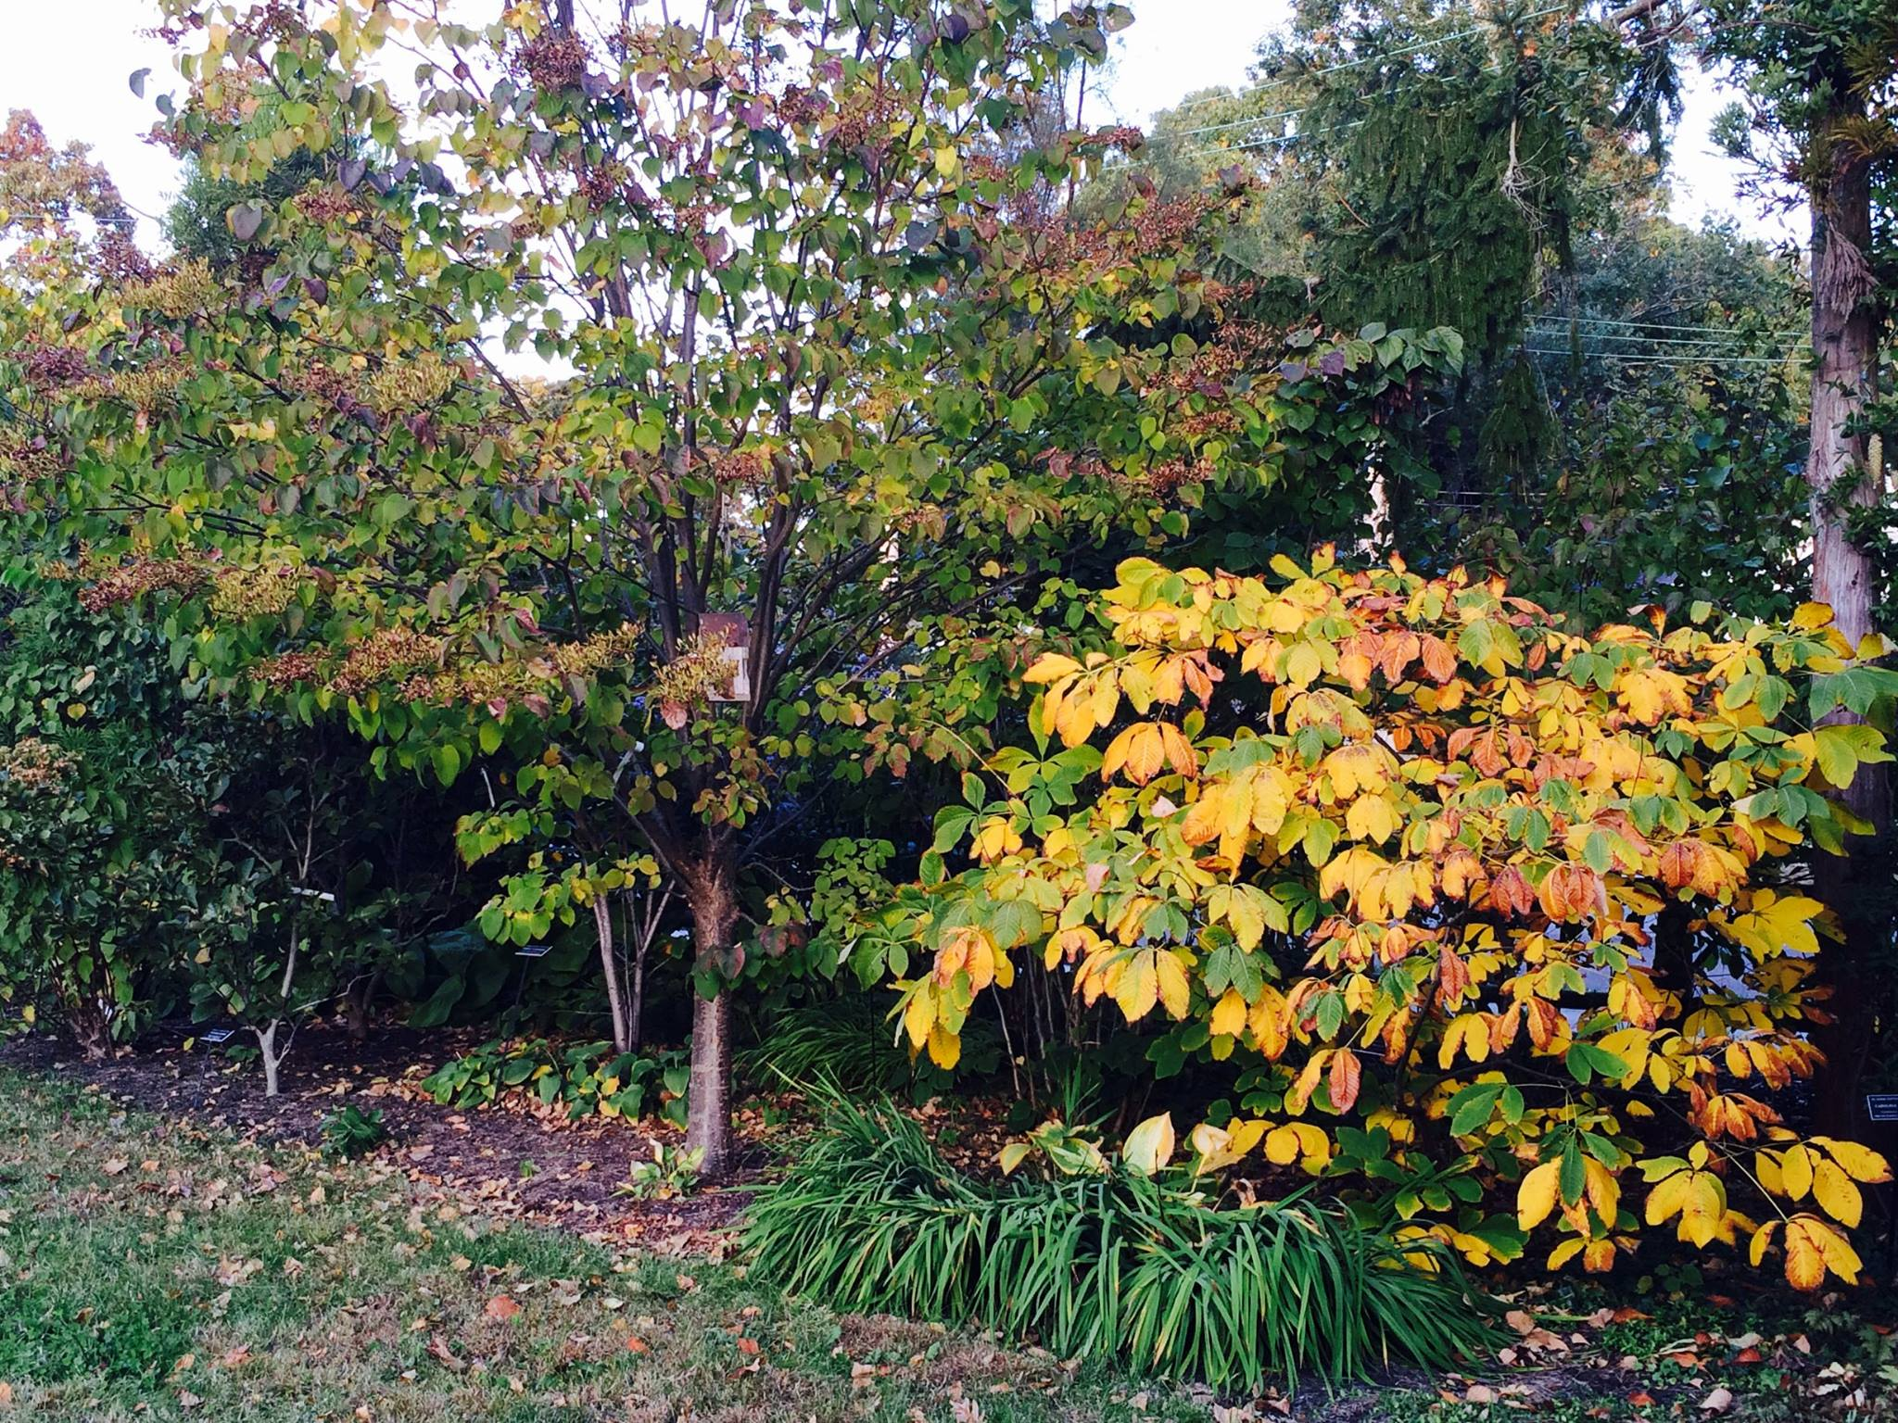
Proposed Ashland Arboretum
The focus of creating an arboretum is for Ashland residents to become familiar with rare species of plants and trees.
The size of this area should not be a challenge as shown by the “Linwood Arboretum” in Linwood, New Jersey. This arboretum’s ares is less than an acre and has over 90 species of plants and trees.
Species of tree, plants and shrubs should only be native.
Funding opportunities will be through CPC or state grants.
Source: https://linwoodarboretum.org

Slide 8
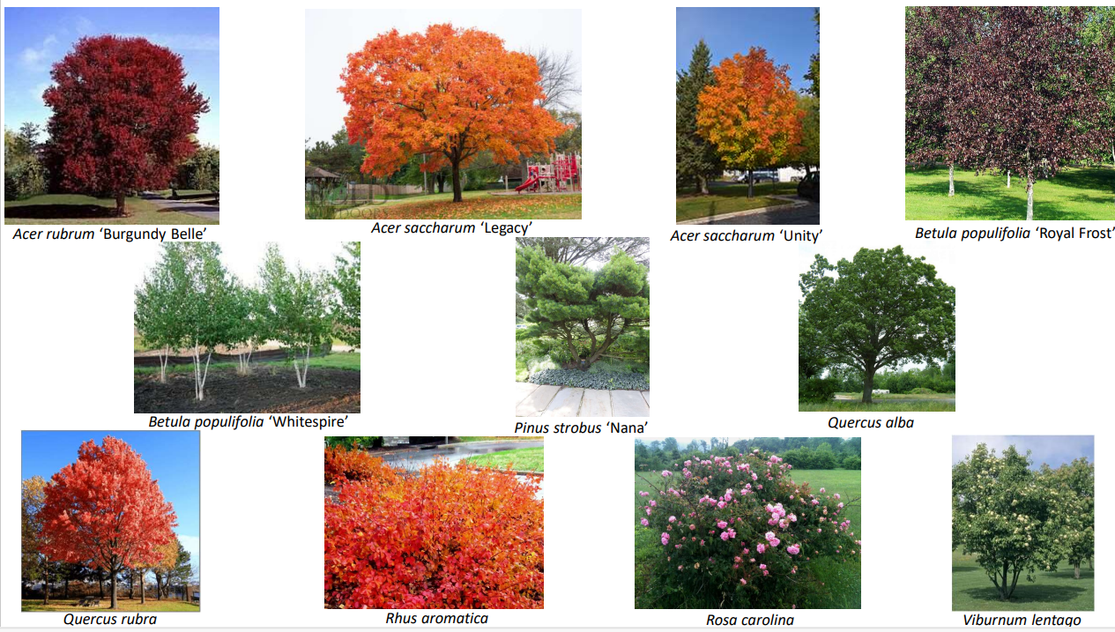
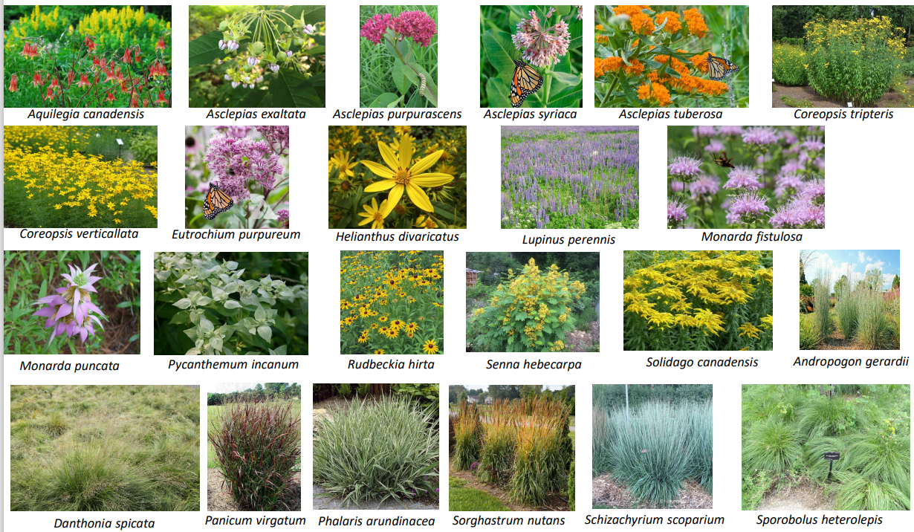
Proposed Ashland Arboretum

Slide 9
Thank you

