Slide 1
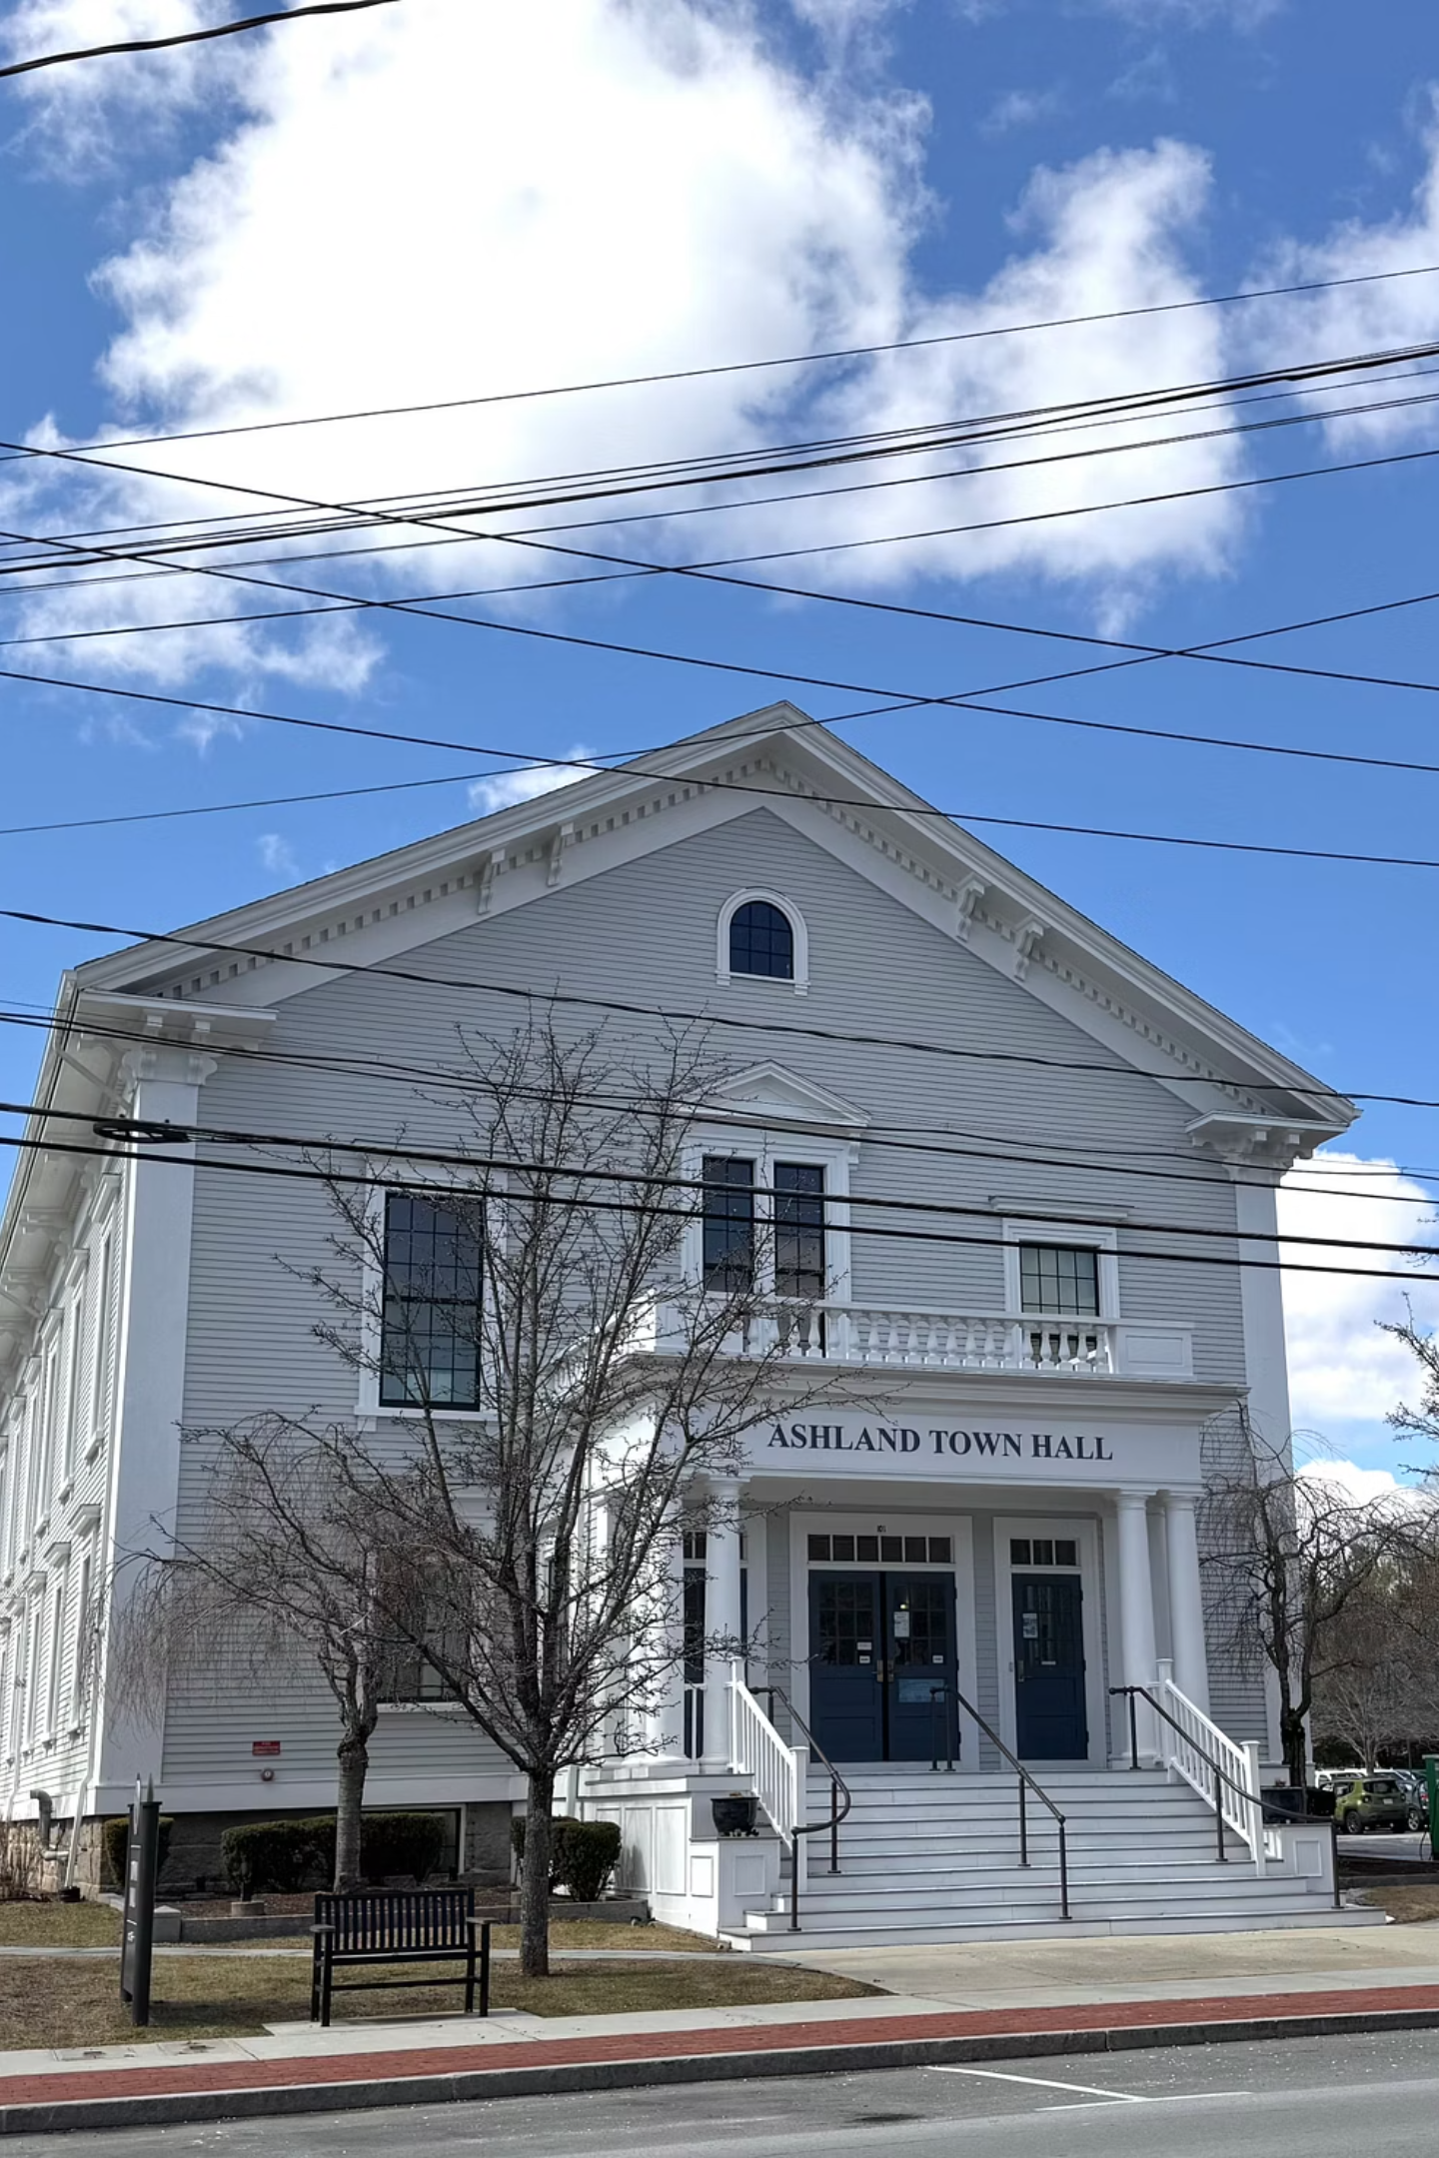
MUNICIPAL FINANCE
FY2026
FY2026 Budget Overview
A comprehensive review of Ashland's fiscal position — comparing FY24 Actuals, FY25 Recap, and the proposed FY26 Budget across revenues, expenditures, and key financial drivers.

Slide 2
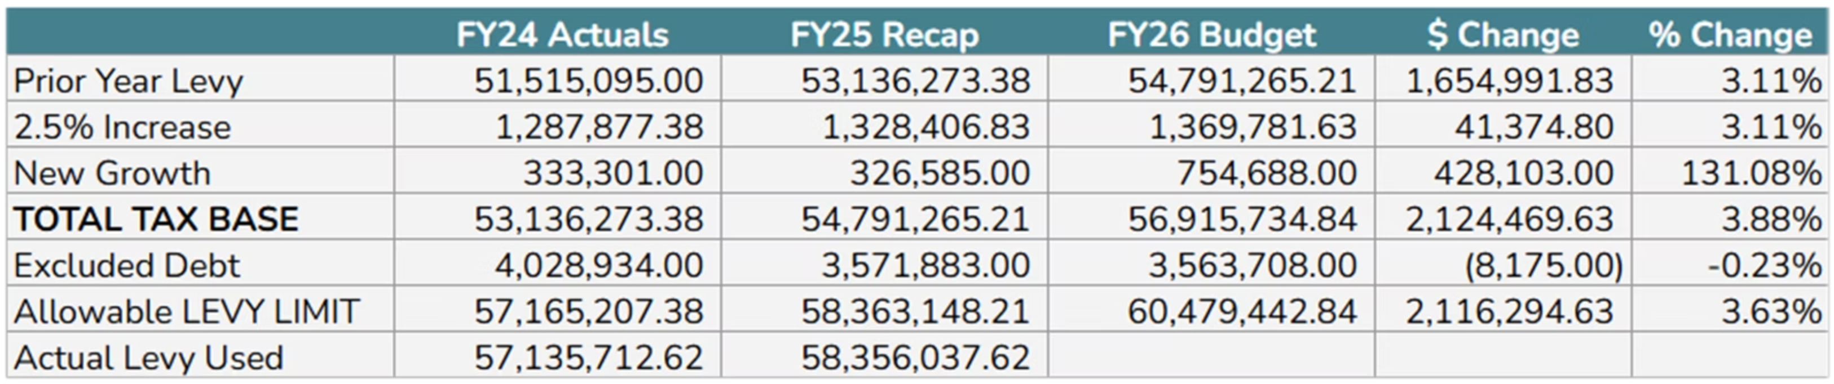
REVENUE
Tax Levy
Property taxes are the Town's largest and most stable revenue source, growing each year by 2.5% plus new growth as allowed under Proposition 2½.
$56.9M
$754K
3.11%
Total Tax Base
New Growth
2.5% Base Increase
Up $2.12M (+3.88%) from FY25
+131.08% vs. FY25's $326,585
Prior year levy plus statutory growth

Slide 3
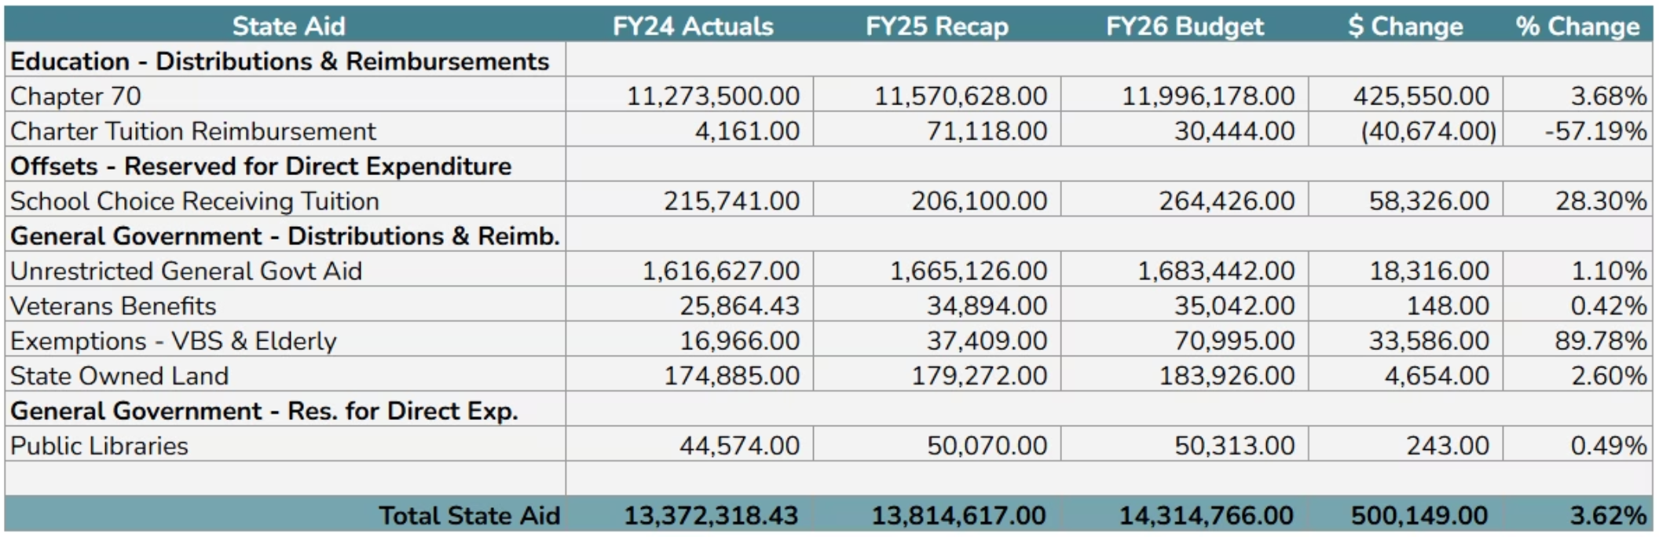
REVENUE
State Aid
Funding from the Commonwealth that supports schools and general government. State aid is the Town's second-largest revenue source for the general fund — but it does not keep pace with rising costs, especially in education and health insurance.
3.68%
Increase in Chapter 70 education aid
1.1%
Increase in Unrestricted General Government Aid
$500K
Overall increase in total State Aid to $14.3M

Slide 4
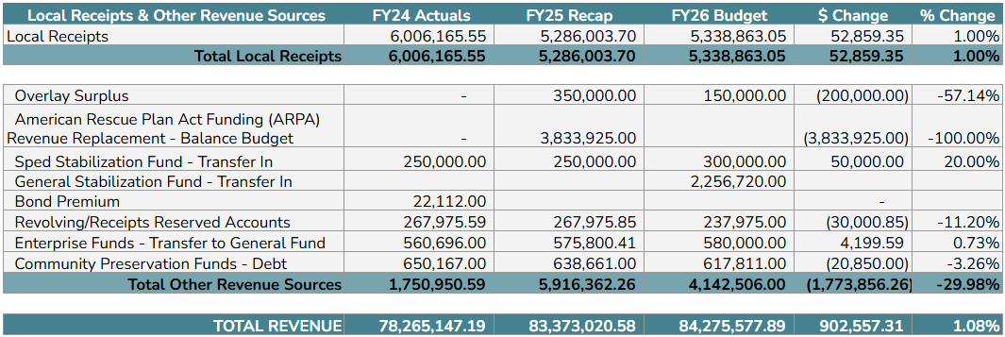
REVENUE
Local Receipts & Other Revenue Sources
Local Receipts
Revenues collected from fees, permits, excise taxes, and other local activity. Total local receipts budgeted at $5.34M — up 1.00% from FY25.
Key Changes in Other Sources
ARPA Funding
General Fund Stabilization
Sped Stabilization
$3.83M used in FY25 — no longer available in FY26
$2.26M drawn down to help bridge the gap
Increased to $300K (+20% vs. FY25)

Slide 5
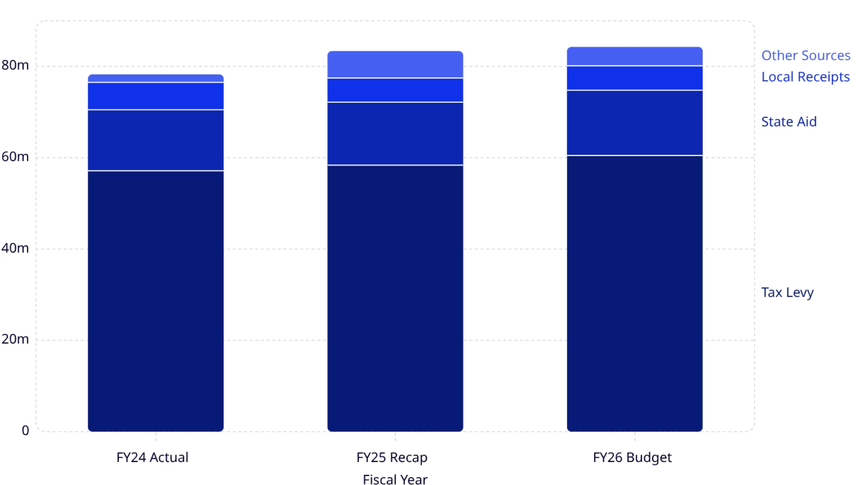

REVENUE SUMMARY
Total Revenue
FY26 Total Revenue: $84.28M
An increase of $902K (+1.08%) over FY25. While overall revenue increased—driven mainly by growth in the tax levy and state aid—the Town still had to rely heavily on stabilization funds to balance the FY26 budget.
Tax Levy
State Aid
Local Receipts
$60.5M — up 3.88%
$14.3M — up 3.62%
$5.34M — up 1.00%

Slide 6

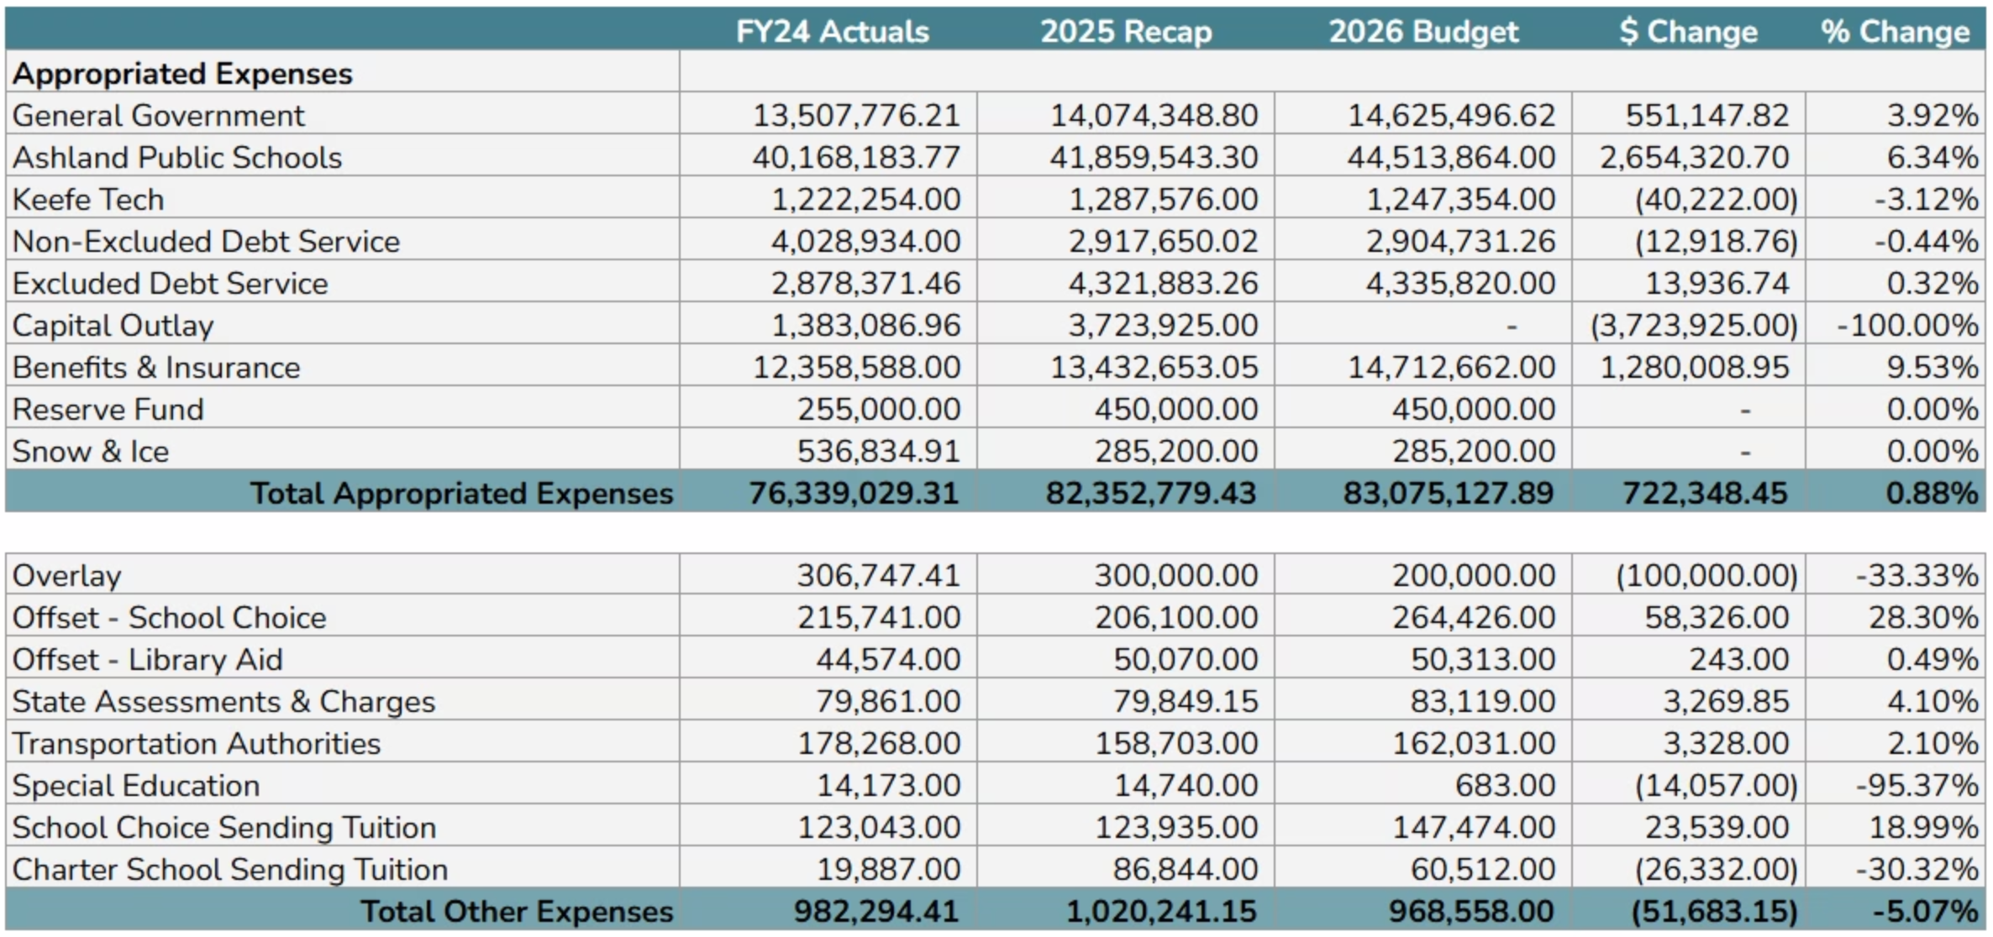
EXPENDITURES
Total Expenses
Total appropriated expenses for FY26 are budgeted at $83.1M — up $722K (+0.88%) from FY25. Key cost drivers include education, benefits and insurance, and public safety.

Slide 7
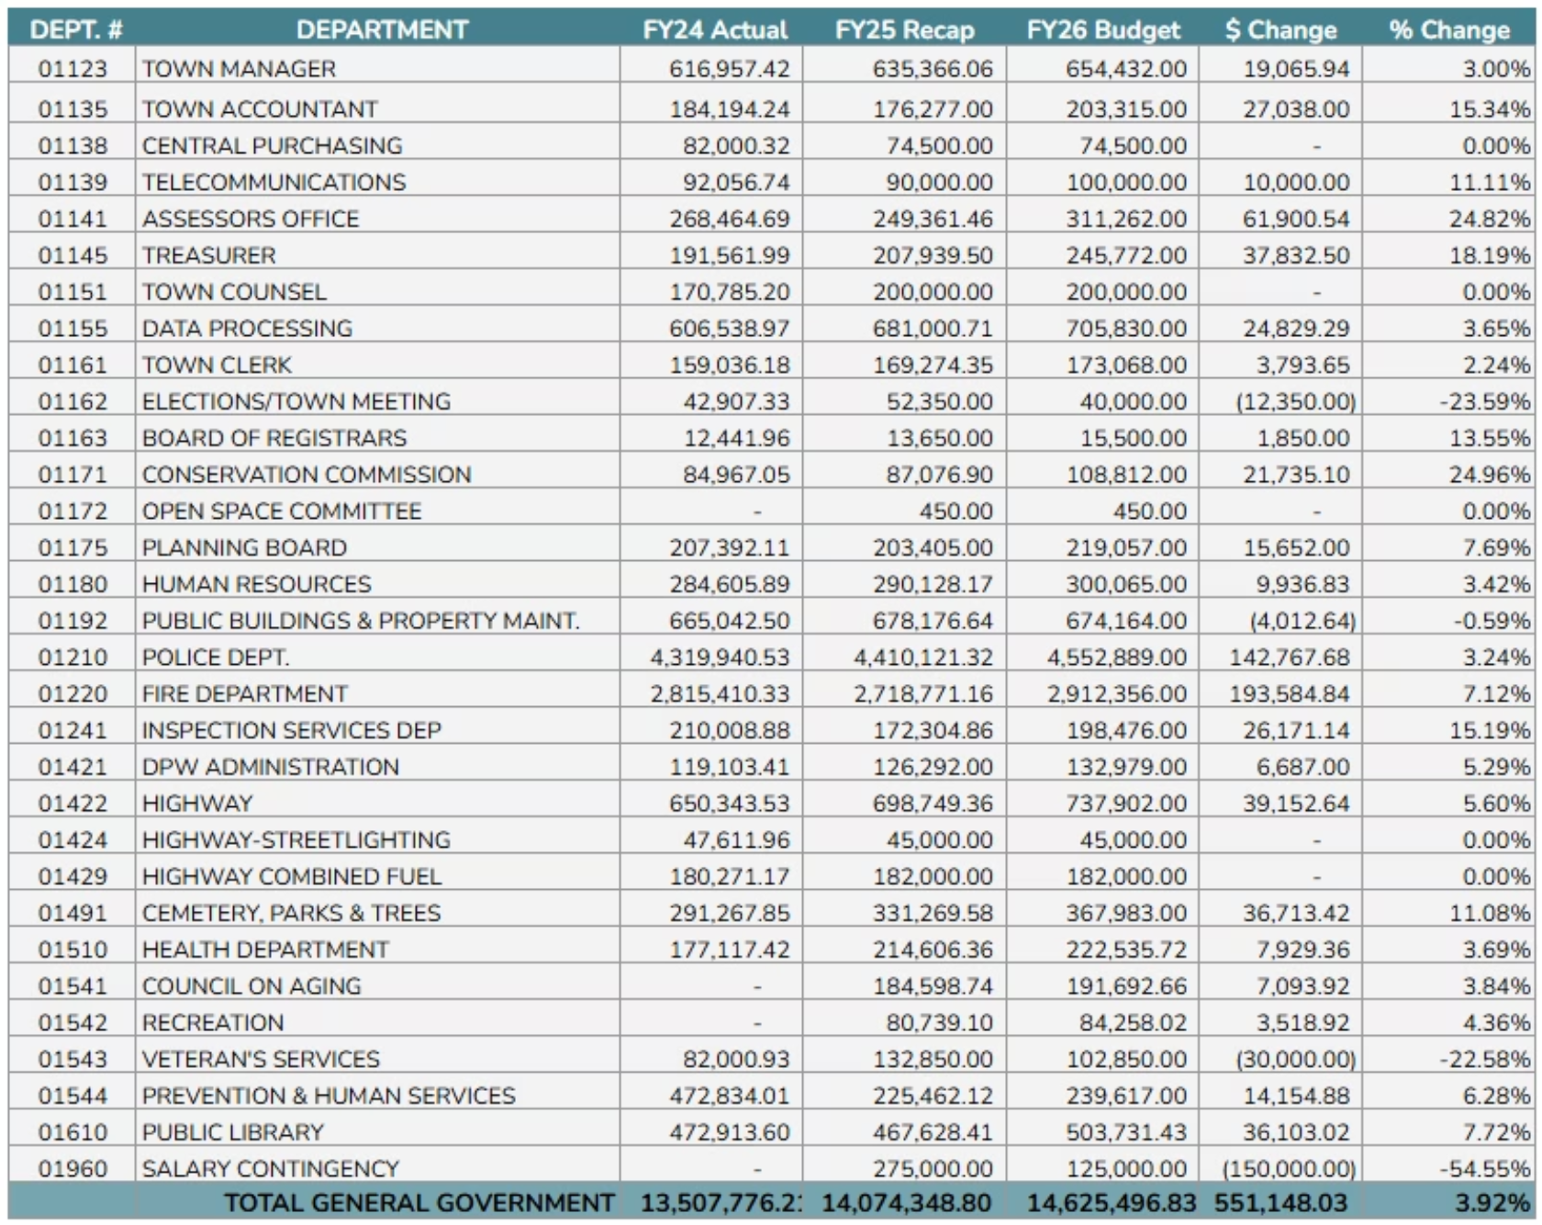
EXPENDITURES
General Government Breakdown
Highlights
Assessors Office +24.8%
Transition to new assessing software with enhanced online mapping tools for residents
Inspections +15.2%
Expanded inspector headcount to meet increased demand
Elections −23.6%
Reduction aligned with the off-year election cycle
Salary Contingency −54.6%
Reduction in the reserve for non-union salary adjustments

Slide 8
EXPENDITURES
Education Spending
Education represents approximately 55% of total appropriations — the single largest category of Town spending, with combined FY26 expenses of $45.76M.
Ashland Public Schools
Keefe Technical School
Combined Education
$44,513,864 — up 6.34% from FY25. The primary cost driver in the budget, reflecting enrollment growth and contractual obligations.
$1,247,354 — down 3.12% from FY25, reflecting updated regional assessment calculations.
$45,761,218 — approximately 55% of total appropriations, underscoring education as Ashland's top fiscal priority.

Slide 9
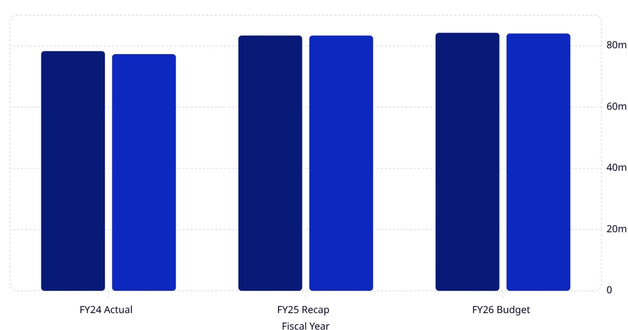
BUDGET SUMMARY
Total Expenditures vs. Revenue
FY26 Budget Balance
Total expenses are budgeted at $84,043,686 — up $670,665 (+0.80%) from FY25. Against total revenue of $84,275,578, the budget projects a surplus of $231,892.
This is a healthy improvement over FY25's balanced position and continues the trend from FY24's $973,318 surplus.
Total Revenue
Total Expenses
Projected Surplus
$84,275,578
$84,043,686
$231,892

Slide 10

FY2026
Key Takeaways
1
Tax Base Growth
New growth of $754,688 (+131%) drives the tax base to $56.9M
2
Reduction in One Time Funds
In FY25 $3.83M of ARPA funds were used. With that funding source no longer available, FY26 Budget relies on stabilization funds to balance the budget.
3
Education Leads Spending Growth
Ashland Public Schools (+6.34%) and Benefits & Insurance (+9.53%) are the primary cost pressures in the FY26 budget.
4
Projected surplus of $231,892
While FY26 shows a small surplus on paper, this is not a sign of financial strength. The Town relies on Free Cash each year to fund capital projects and to replenish stabilization accounts. Because FY26 uses $2.55M in stabilization funds to balance the budget, this small surplus is not enough to replace what was used—leaving the Town with less flexibility going forward.

